Slide 1
Church Presentation for Church Outlook
The heart of this trip
Express the purpose and mission of your trip, connecting it with the faith and values of fellow believers
What you will be doing in this trip
Outline the key activities and focus of your work during the trip
Why it matters/benefits
Explain the significance of the trip to the church community and its importance to you personally
How you can Support This Cause
Detail the ways others can get involved and support this mission
Biblical Foundation to support this trip
Scriptures that aligns with the purpose of your trip
Scriptural principles to support your cause

Slide 2


Türkiye & Greece
Church Presentation Example

Slide 3
Heat Of The Trip
We Go to Serve
To be salt and light in a world that needs God's presence, bringing hope and encouragement while showing His love and care for all cultures.
We Go to Love
To demonstrate our faith through actions that bear spiritual fruit, responding to the needs of others and supporting them with compassion.
We Go to Live Out Our Faith
To put our beliefs into practice, embodying the message of Christ in everything we do.
We Go to Understand
To seek God's heart for these people, learning about their lives, and sharing in their experiences.

Slide 4
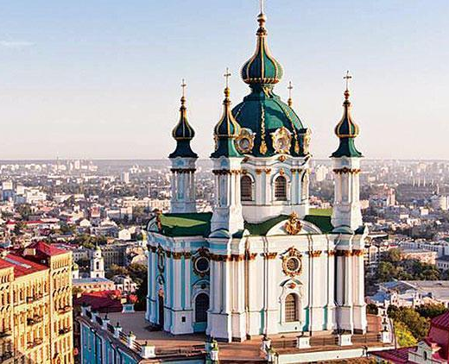
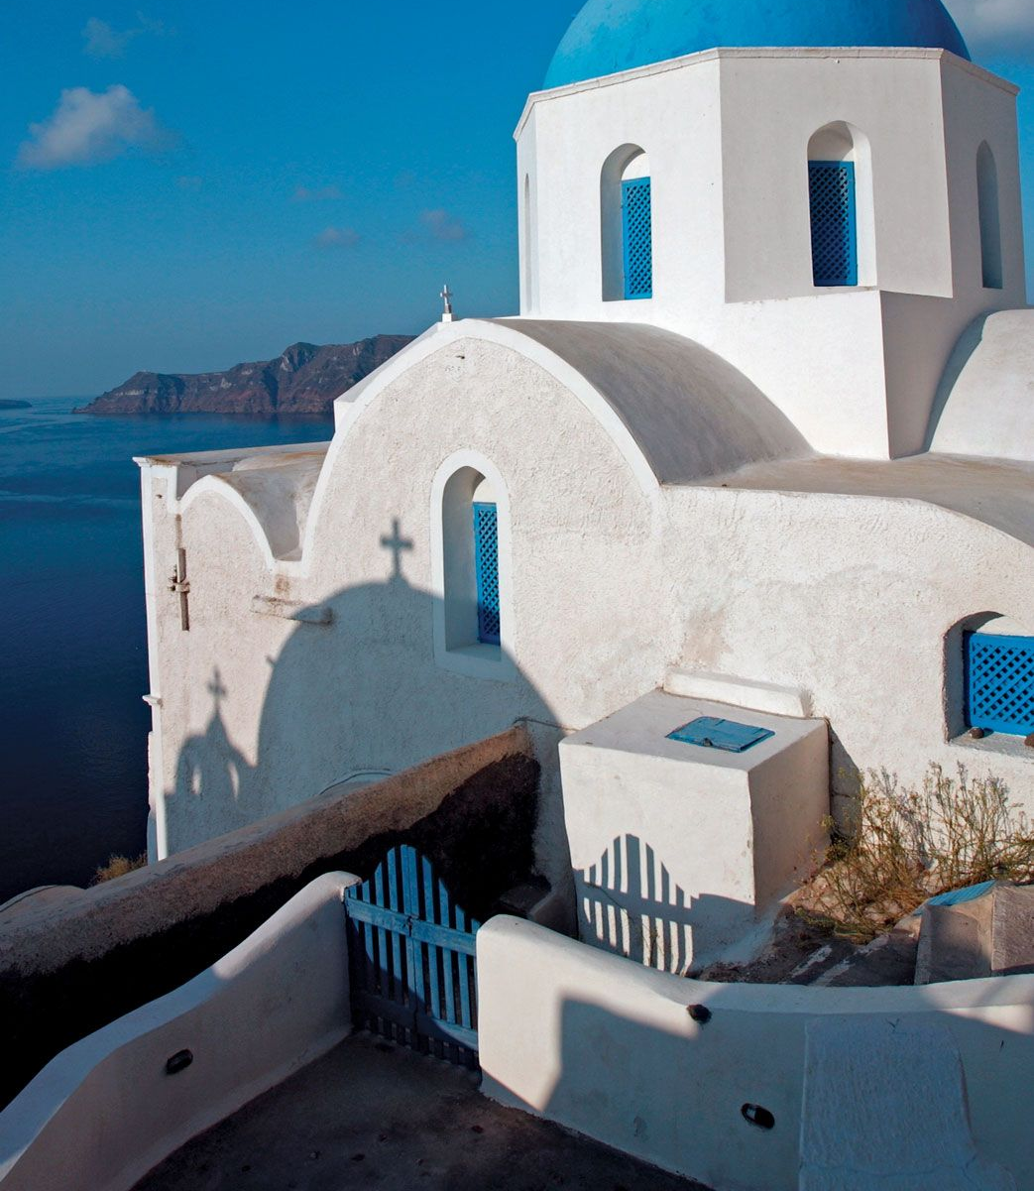
Trip Highlights and Activities
Turkey:
    Visiting the seven Churches of revelation
    Explore Hagia Sophia In Istanbul. Discover the architectural wonder that has been both a cathedral and a mosque, representing the blend of Christianity and Islam.
  Greece:
    To engage with and learn about the culture of local churches and the lives of fellow believers.
    Tour Meteora Monasteries: Experience the spiritual significance and breathtaking beauty of monasteries built atop towering rock formations, reflecting the country's Orthodox Christian heritage.

Slide 5

Why it matters
To Me
1.Explore and immerse myself in a new culture, enhance my cultural intelligence, and cultivate my missionary skills.
To the Church
1. Gain insight into a new culture while exploring a mission field with potential future opportunities.
2. Educate churches on how God operates in diverse cultures and the variations in church practices.

Slide 6
How you can Support this Cause
Prayer
Seek guidance and support throughout the journey.
Advice for Cultural Encounters
Tips for navigating and appreciating cultural differences.
Sharing with Friends and Family
Encourage others to support the mission through awareness and contributions.
Funding Goal: $4,000
Expenses Include:
Flight tickets
Meals, Lodging, Transportation, and insurance.
Service projects

Slide 7
Biblical Foundation to support this trip
1 Peter 4:10
“As each has received a gift, use it to serve one another, as good stewards of God’s varied grace.”
Acts 1:8 “But you will receive power when the Holy Spirit comes on you; and you will be my witnesses in Jerusalem, and in all Judea and Samaria, and to the ends of the earth.”
1 Corinthians 3:6–7 “I planted, Apollos watered, but God was causing the growth. So then neither the one who plants nor the one who waters is anything, but God who causes the growth.”
1 Chronicles 16:24 “Declare his glory among the nations, his marvelous deeds among all peoples.”

