Slide 1

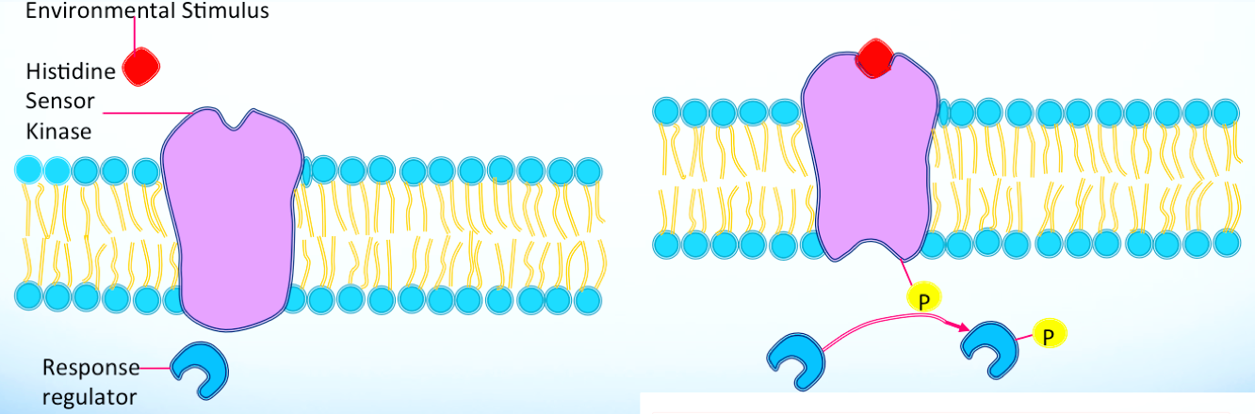
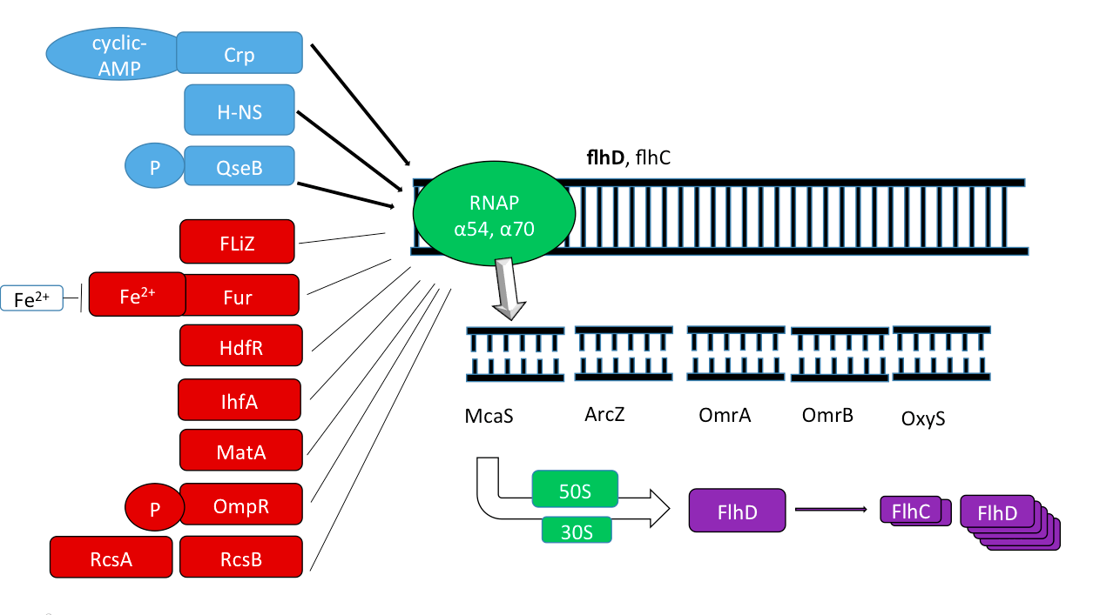
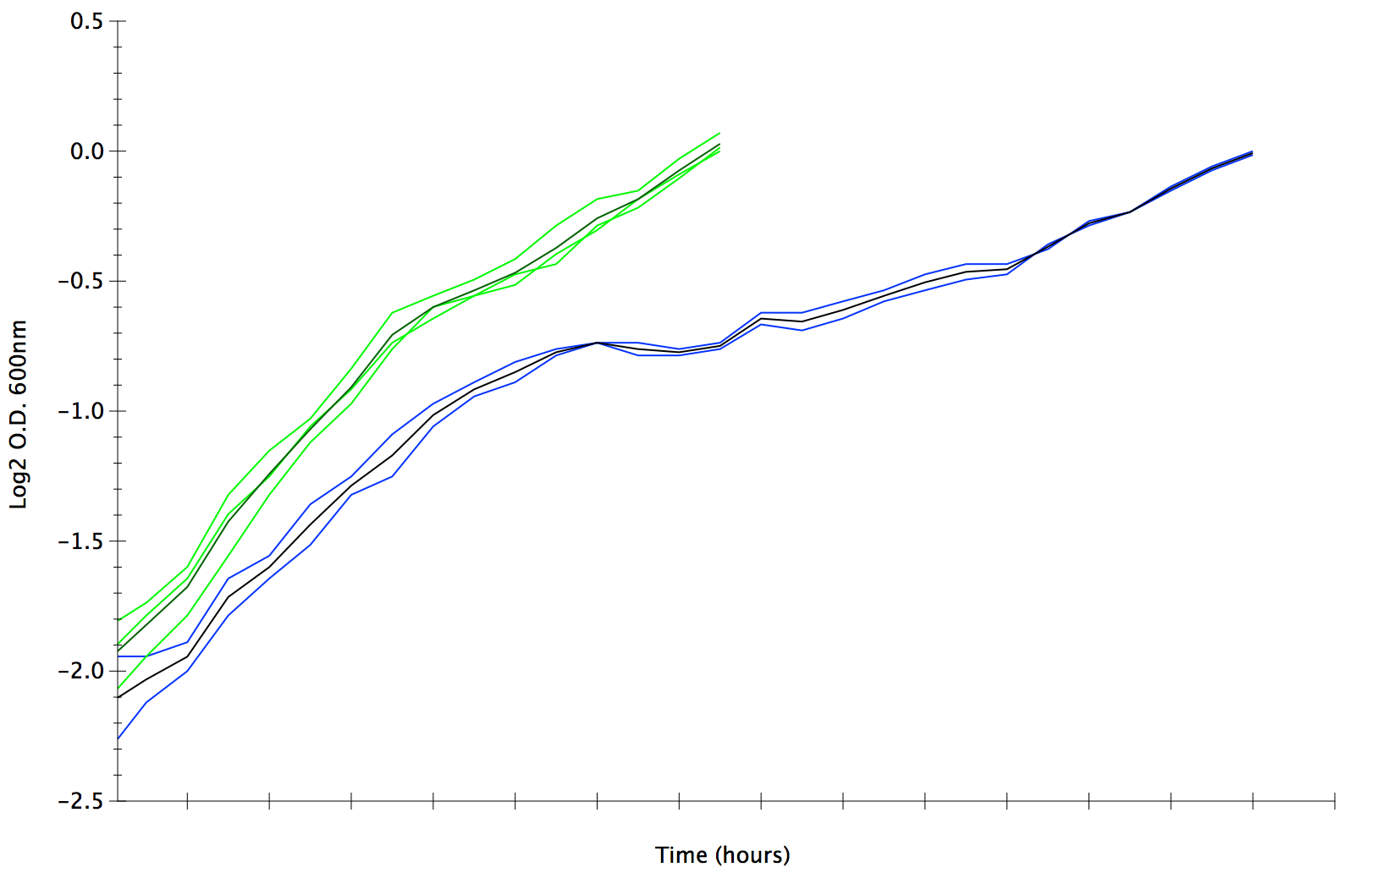
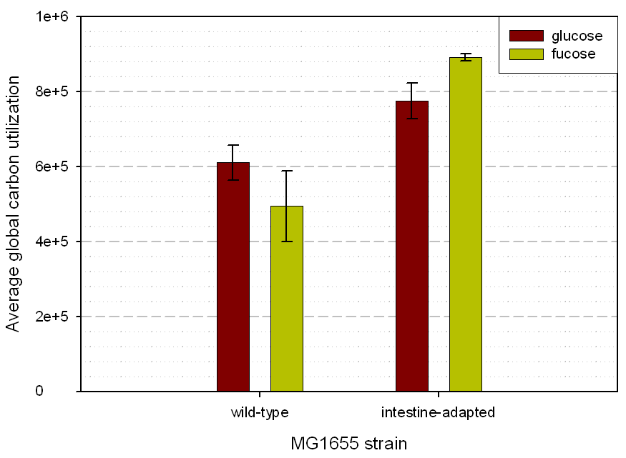
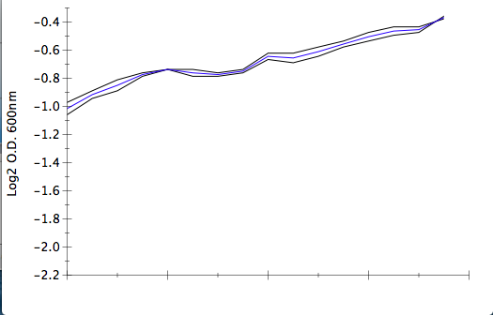
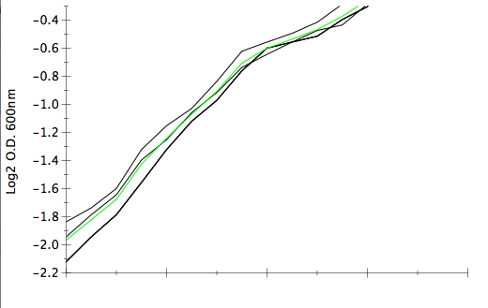
Title of Research Project
Name of Student(s)
Abstract and/or Background
Results and/or Conclusion
Background: The phenomenon of how bacteria communicate is called quorum sensing (QS), where the receptor QseC causes down-stream genetic regulation from the response of autoinducers released from bacteria, or even in response to epinephrine and norepinephrine. Previous research shows the connection of QS with motility, and pathogenicity. We have shown a connection between the receptor kinase QseC and competitive fitness through nutrient utilization. Methods: Since no one had previously measured how QS affects bacterial physiology of E. coli, we measured competitive colonization within the murine model and the growth rates on individual carbon sources of the strain E. coli MG1655∆qseC (MG1655 ∆qseC). Results: There was a significant competitive advantage for colonization without the sensory kinase QseC. We found that QS is not limited to the induction of virulence and motility as shown in previous studies, but that downstream central carbon metabolism is heavily influenced. Specifically, MG1655 ∆qseC has a quicker growth rate than the wild type on both catabolite-repressing and non-catabolite repressing sugars. Conclusions: Our results suggest that it might not be wise to target quorum sensing for antimicrobials because it could potentially promote the growth of the undesired pathogens. The generation time decrease found with MG1655 ∆qseC demonstrates the connection between carbon metabolism, QS, intestinal adaptation, and colonization. Understanding the mechanisms behind QS, will also lead to greater understanding of how both commensals and pathogens interact within the intestinal microbiome.
Results
There was a significant competitive advantage during colonization without the sensory kinase QseC. We found that QS is not limited to the induction of virulence and motility as shown in previous studies, but that central carbon metabolism also is heavily influenced (Fig. 2 and Fig. 3). Since QseC is involved in the regulation of the flhDC region, we assumed that MG1655 ∆qseC would respond similarly to the intestine-adapted strain; we expected there would be a decrease in growth rate for catabolite repressing sugars and an increase in growth rate on non-catabolite repressing sugars (Fig. 4). However, MG1655 ∆qseC grows faster than the wild-type on both catabolite repressing and non-catabolite repressing sugars (Fig. 5 and Table 1). Not only is the growth rate decreased, there is a significant change to the typical diauxic transition from a catabolite repressing sugar to a non-catabolite repressing sugar (Fig. 6). Without QseC, the strain skips the diauxie that typically occurs.
Conclusions
We have shown that it might not be wise to target quorum sensing for antimicrobials since MG1655 ∆qseC has a significant fitness advantage within the murine intestine (6). MG1655 ∆qseC is also utilizes both catabolite and non-catabolite repressing sugars better than the wild-type, including the ability to skip the traditional lag that is defined as catabolite repression (5). We show that bacterial communication through QS limits colonization and is involved with directing which carbohydrates are metabolized based on bacterial populations. There is now a need to redefine the traditional lag that occurs between the utilization of glucose and lactose based on catabolite repression. The generation time decrease found with MG1655 ∆qseC demonstrates the connection between carbon metabolism, QS, and colonization. Understanding the mechanisms behind QS will lead to greater understanding of how both commensals and pathogens interact within the intestinal microbiome.
A
B
Table 1. Calculated growth rate of E. coli MG1655 and E. coli MG1655 ∆qseC on individual carbon sources. The particular growth rates are shown along with the relative advantage that the strain has without the sensory kinase QseC.
Carbohydrate | MG1655 wt µ | MG1655∆qseC µ | Percent Advantage
Galactose | 0.2802 | 0.5055 | 44.58%
Glucose | 0.5496 | 0.7524 | 26.94%
Gluconate | 0.6406 | 0.7981 | 19.74%
Lactose | 0.5714 | 0.6972 | 18.04%
Fucose | 0.4304 | 0.5144 | 16.30%
Fructose | 0.5181 | 0.5883 | 11.93%
Maltose | 0.4287 | 0.7987 | 46.30%
Arabinose | 0.52745 | 0.55003 | 4.10%
Figure 1. QseC the adrenergic receptor kinase
Activation of QseC is followed by the phosphorylation of the response regulator QseB (A). QseB is known to regulate pathogenicity as well as the motility master regulator FlhDC (B).
A
Introduction and/or Research Question
A
For bacteria to colonize and persist within the intestine, they need to overcome a lag phase by utilizing available nutrients or attaching to intestinal epithelium to overcome this lag phase (1). In vitro lag is tied to the idea of catabolite repression, where there is a pause in growth based on the need to recover enzymatically from the utilization of a catabolite repressing sugar to a non-catabolite repressing sugar. The relationship between carbon catabolism and colonization within the intestinal microbiome is just beginning to unfold.
Quorum sensing (QS) is the phenomenon of how bacteria communicate. The adrenergic receptor kinase QseC regulates genes in response to autoinducers released from bacteria as well as responding to epinephrine and norepinephrine (Fig. 1). The QseBC pathway is based on both cell-cell signaling and an adrenergic response effecting bacterial gene expression. Previous studies using Enterohemorrhagic E. coli QS have correlated microbial communication with both pathogenic response and motility (via flhDC) (2, 3). Non-pathogenic E. coli MG1655 (MG1655) was used in this study to understand the impact of QS apart from pathogenicity since the previous studies of QseBC were performed using a pathogen (enterohemorrhagic E. coli) (2). What does QseBC regulate in other members of the intestinal microbiota to promote general health?
We chose to distinguish between the impact of QS on the ability to colonize apart from its regulation of pathogenicity. Instead of using EHEC, we used commensal E. coli in this study since it has the regulatory QS system and motility without pathogenesis factors. Furthermore, we know how E. coli adapts to the intestine with regard to motility.
Figure 2. Colonization of MG1655 and MG1655∆qseC
(A) Colonization of MG1655 and MG1655∆qseC fed low at 10⁵ CFU. Showing the competitive advantage without the receptor QseC.
(B) Colonization resistance of MG1655. MG1655∆qseC with 10⁵ CFU was able to overcome the colonization resistance of the wild type MG1655 at 10⁸ CFU.
B
Glucose and Lactose Diauxie with MG1655 and MG1655∆qseC
Optical Density at 600nm from 0.2-1.0
Figure 3. Competitive fitness advantage.
Quantification of fitness was based on the direct comparison of log CFUs of one species to another. There was a significant fitness advantage of group A, if not even more with group B through overcoming colonization resistance.
Future Work
Figure 4. Intestine adapted strain preferring non-catabolite repressing sugars over catabolite repressing sugars.
Metabolic capacity of E. coli strains during growth on minimal glucose and minimal fucose media. Cells were grown to mid-log phase on minimal glucose (red) or minimal fucose (yellow), harvested in chloramphenicol, and loaded into Biolog GN2 Microplates for readings every 15 minutes for 24 hours. The area under the curve for each carbon source oxidized in the Biolog plate was added together to determine the metabolic capacity for E. coli strains (using arbitrary units). Without flhDC there is a greater increase in utilization of non-catabolite repressing sugars (fucose). The catabolite repressing sugars
Determine bacterial growth based on QseC receptor agonists and antagonists.
Determining how the host sympathetic and parasympathetic response influences the bacterial adrenergic receptors.
Distinguish the direct targets of QseBC as opposed to the genetic regulation through FlhDC.
Find the mechanism at which the strain E. coli MG1655 ∆qseC skips over the lag phase and skips over catabolite repression.
Work with other strains that are predominant within the intestine to determine the changes in carbon metabolism based on Quorum sensing.
C
MG1655
Time in Hours
D
MG1655 ∆qseC
Growth on 0.02% Glucose
1 2 3 4 5 6 7 8 9 10 11 12 13 14
1 2 3 4 5 6 7 8 9 10 11 12 13 14
B
1 2 3 4 5 6 7 8 9 10 11 12 13 14
Methods
We measured competitive colonization within the murine model and the growth rates on individual carbon sources of the strain E. coli MG1655 (MG1655) and E. coli MG1655 ∆qseC (MG1655 ∆qseC). Single carbon sources were measured using MOPS minimal media as defined by Neidhardt, with the final concentration of the sugars being 0.2% (4). Measurements were taken at an optical density (OD) at 600 nm. The sugars tested were galactose, glucose, gluconate, lactose, fucose, fructose, maltose, and arabinose. All the sugars tested were then combined together to determine if there was an overall growth advantage on the combination of sugars. The traditional diauxic lag was studied using both strains on 0.05% glucose and 0.15% lactose (5). Measurements were taken every 15 minutes to determine the growth of MG1655 and MG1655 ∆qseC.
A
B
9 9.5 10 10.5 11 11.5 12 12.5 13
References and/or Acknowledgments
Log10 Optical Density at 600nm
Time in Hours
Time in Hours
Time in Hours
Time in Hours
Figure 6. MG1655∆qseC skipping over the traditional lag based on catabolite repression. The typical “diauxie” that is described by Ulman and Monod, where there is a pause between the utilization of glucose and the utilization of lactose is shown with MG1655. However, without QseC the lag is skipped over and logarithmic growth is continued without the prominent break around the optical density of 0.6 nm. MG1655 ∆qseC is represented by the green lines and MG1655 is represented by the blue lines. The standard deviations of the collected optical densities are shown (A), as well as the averages defined by the darkened line (B,C,D) with emphasis of the optical density of 0.2-1.0 (B). Part C and D are the graphs of MG1655 and MG1655 ∆qseC respectively, from O.D. 0.5 to 0.68. This shows the exaggerated lag that typically occurs with the wild type based on catabolite repression, while MG1655 ∆qseC does not undergo the same lag.
Allinson, C., & Hayes, J. (1996). The Cognitive Style Index. Journal of Management
Studies, 33(1), 119–135.
Allport, G. W. (1937). Personality: A psychological interpretation. New York: Holt &
Co.
Battalio, J. (2009). Success in distance education: Do learning styles and multiple
formats matter? American Journal of Distance Education, 23(2), 71-87.
Beaumaster, S., & Long, J. A. (2002). Pedagogy, technology and learning styles—
their effect on the online learner. Proceedings from National Conference on Alternative
and External Degree Programs for Adults ’02, Pittsburg, PA, 80-97. Retrieved from
http://ahea.org/files/pro2002beaumaster.pdf
C
4 4.5 5 5.5 6 6.5 7
MG1655 MG1655∆qseC
Figure 5. MG1655 ∆qseC has an increased growth rate on both catabolite repressing and non-catabolite repressing sugars. There is an increased rate of growth based on 0.2% sugars and MOPs minimal media as defined by Neidhart (1974). Shown is the increase on glucose (A), lactose (B) and the combination of sugars that were individually tested and listed in Table 1 with still a final concentration of 0.2% in the sugar mixture (C).

