Slide 1
ENTERPRISE SOURCING, BUYLU, SUPPLIER MANAGEMENT, & ANALYTICS
Spring 2025 Training
Procurement & Payment Services
April 10, 2024

Slide 2
ENTERPRISE SOURCING
Dawn Neal, Shawn Short, & Mary Franklin
April 10, 2025

Slide 3
Topics of Presentation
1. Sourcing Team Purpose 2. Accessing catalogs and usage 3. Shopping Dashboard 4. What’s New in Sourcing 5. Quick Overview of the New Sourcing Module
3

Slide 4
Enterprise Sourcing can offer guidance for your sourcing needs
Centralizing sourcing efforts can improve compliance with requirements and standardize procurement practices, leading to greater efficiency and risk mitigation.
Experience researching Information for products and services in multiple portfolios.
Provide assistance with large or small projects and obtain quotes.
Aid in getting the best product and service for your department.
Whatever the need, we are here to help!

Slide 5
Catalog vs. Non-Catalog
Pros for Catalog vs. Non-Catalog Orders
Less manual entry
Able to search the catalogs for Suppliers, product information, pricing & availability
Commodity codes and product descriptions are provided
PO is automatically generated after financial approvals of the requisition and no buyer processing is required
Ability to create customized lists within the punchout catalogs- reach out to your sourcing analyst for assistance.
Multiple quotes are still required for orders over $15,000 and Branding Purchases $1000 or more. Please reach out to your buyer for additional information.
5

Slide 6
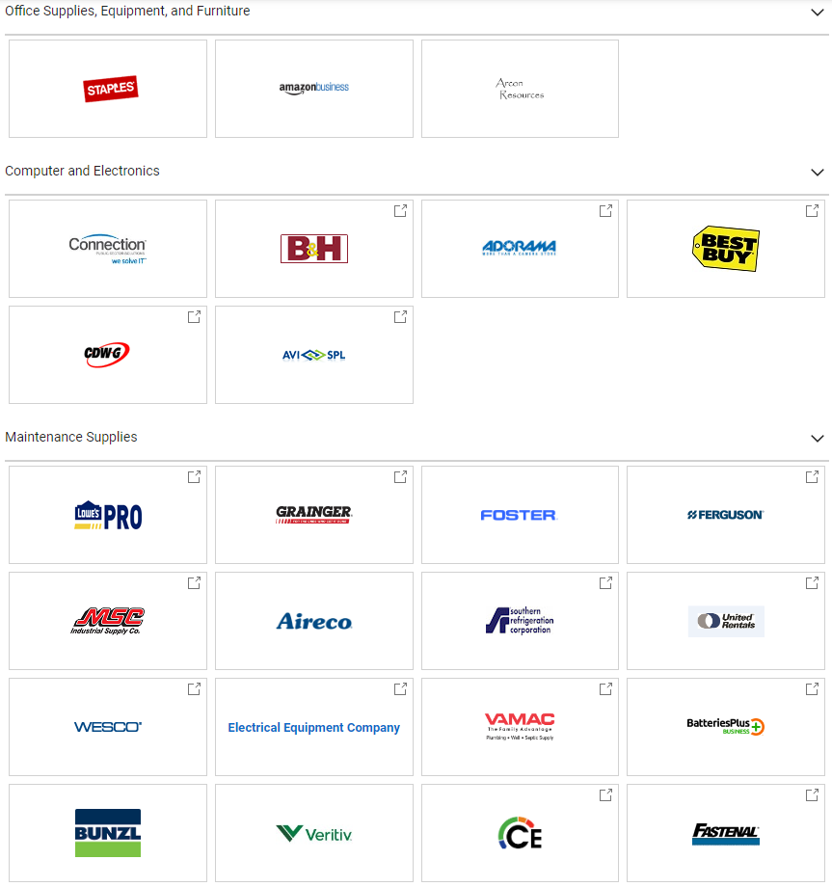
Catalogs Types
BuyLU Showcase/Punch Out/Hosted Catalog Tiles
Punch-out Catalog
Hosted Catalog
Self-Managed Catalog
6

Slide 7
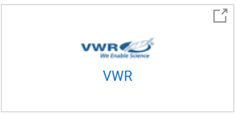
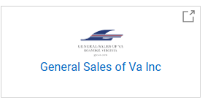
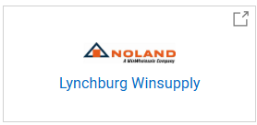
New Punchout Catalogs

Slide 8
Accessing Catalogs

Slide 9
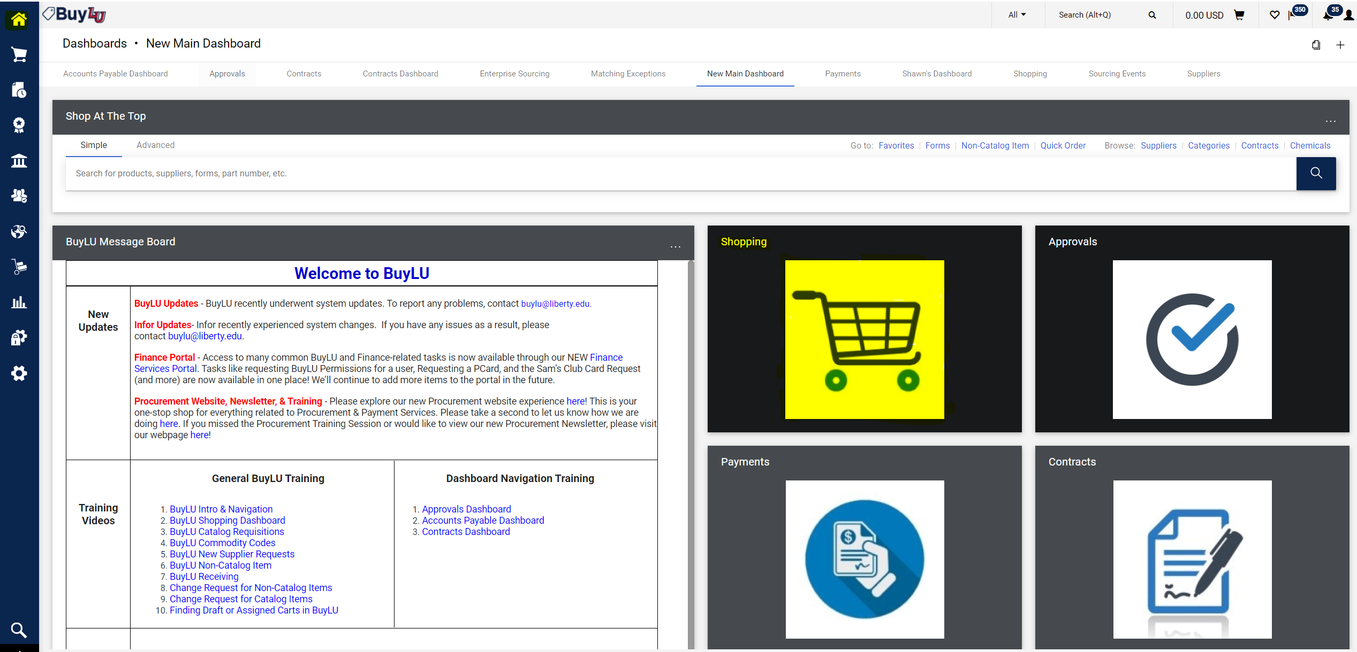

Slide 10
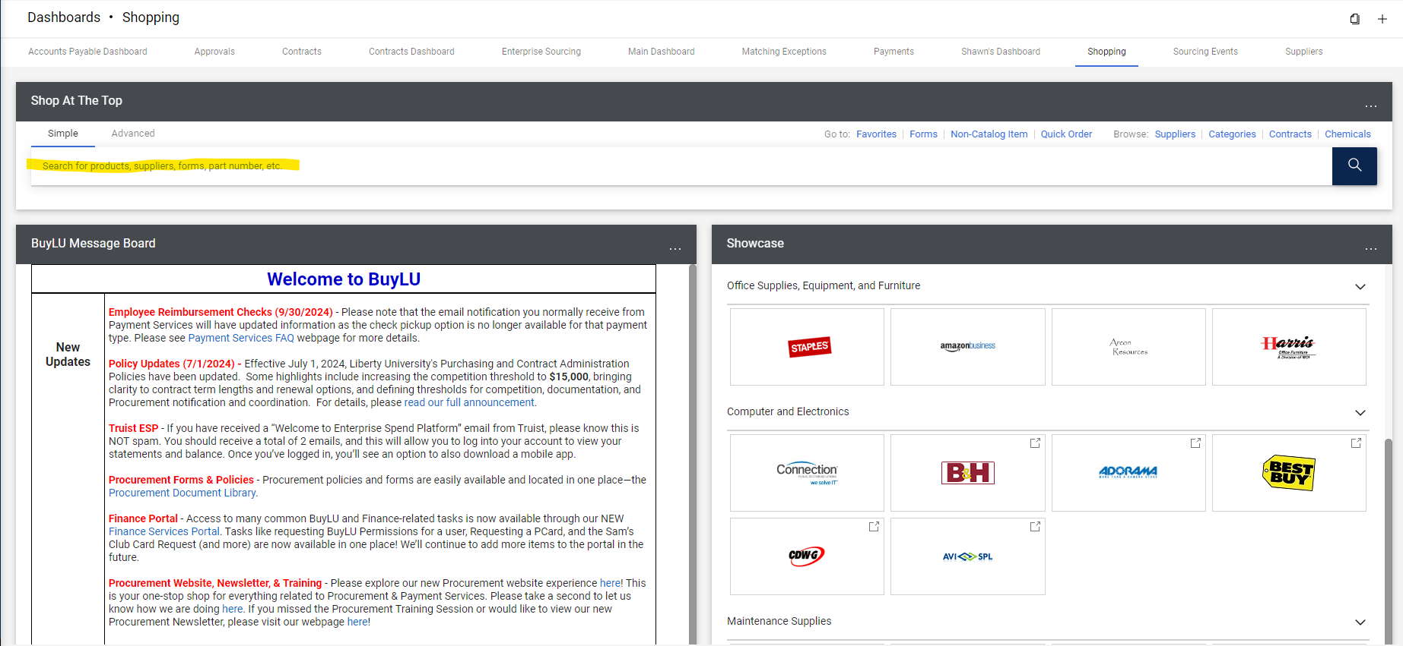
Shopping Dashboard

Slide 11
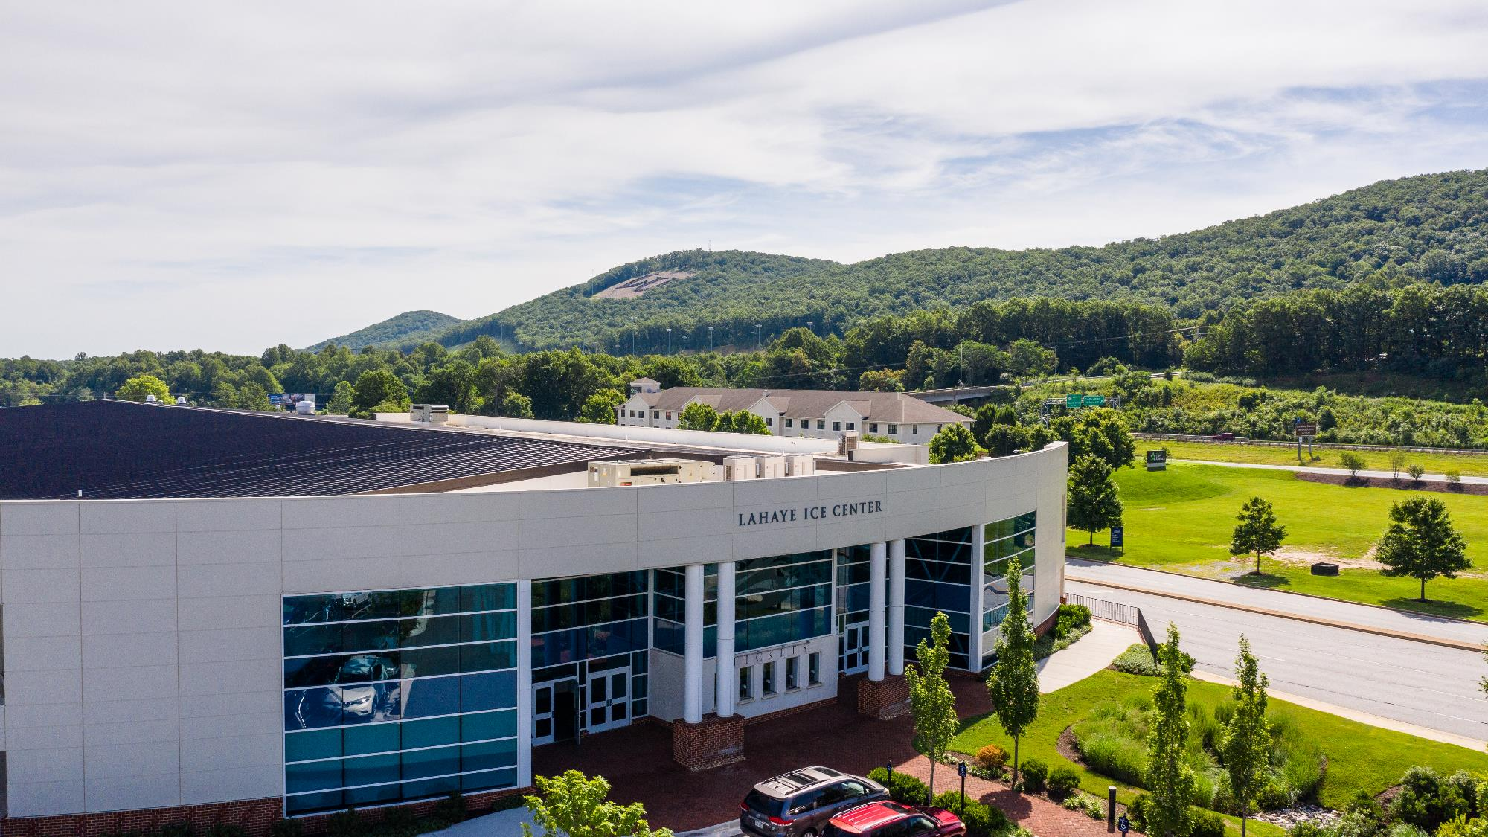

Slide 12
Helpful Hints for Catalog Purchases
Always create a receipt once you have received the product in acceptable condition.
Always report damages immediately to either the supplier or by emailing enterprisesourcing@liberty.edu.
For catalog returns, reach out to the supplier or email enterprisesourcing@liberty.edu.
Once your order is complete and invoices are paid, please be sure to review the PO to ensure it has been closed.
Check the warehouse Repurpose Furniture Inventory on this website for free furniture before purchasing new furniture. https://www.liberty.edu/campus-logistics/warehouse-services/

Slide 13
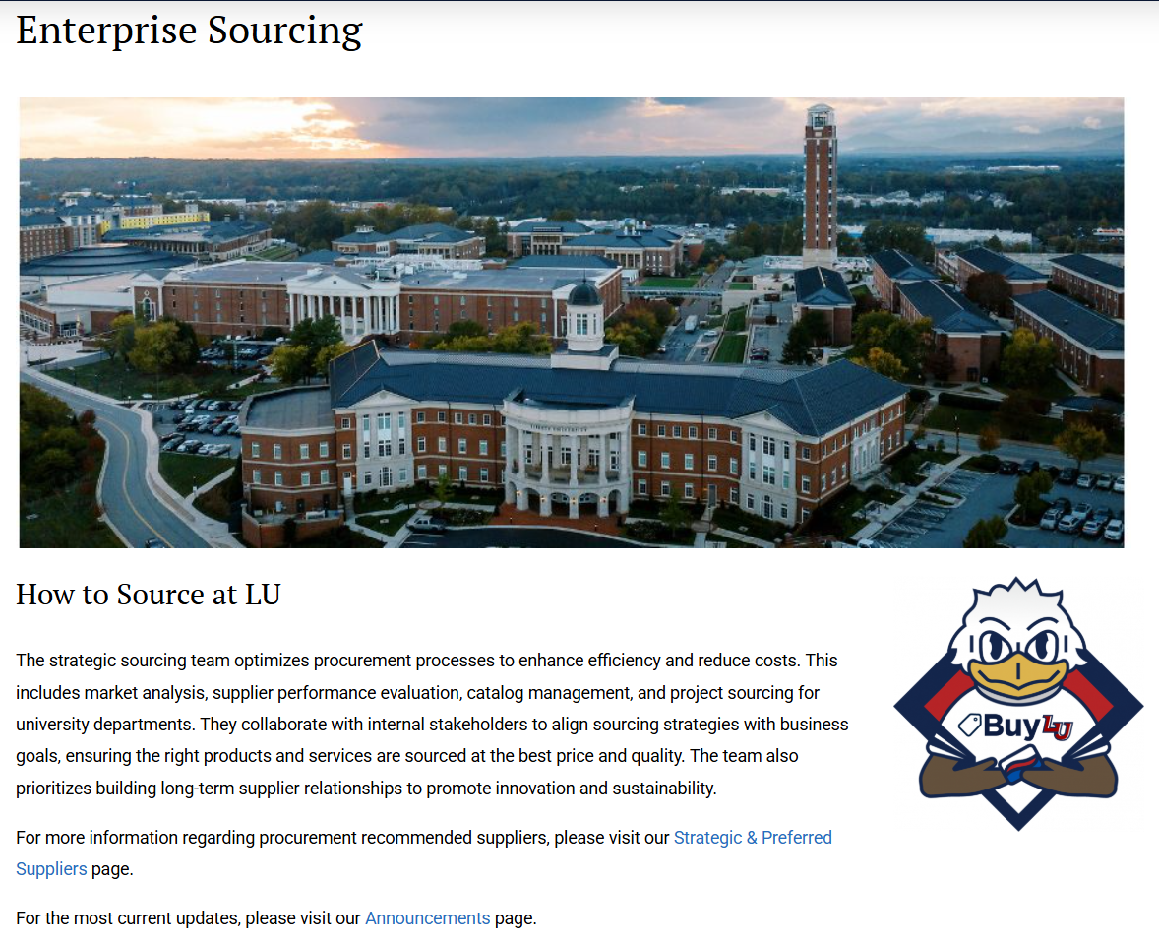
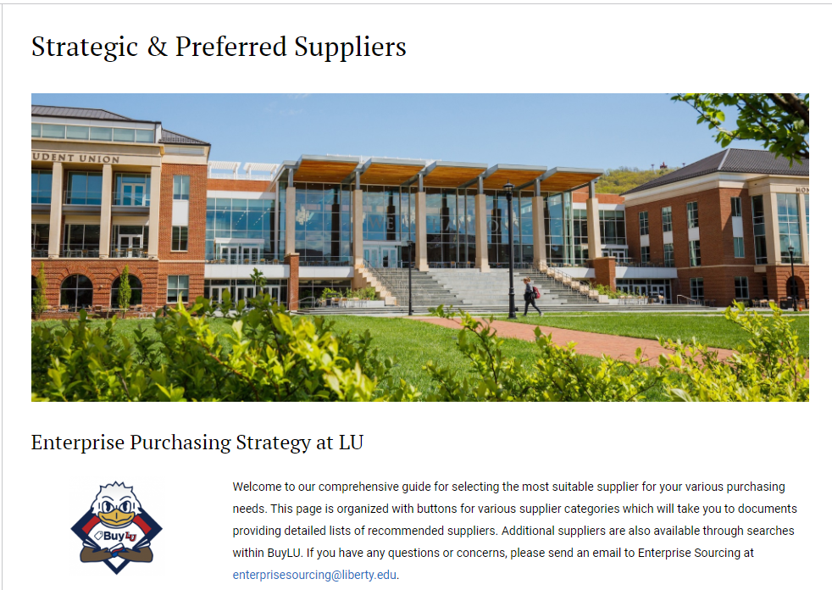
What’s new in Enterprise Sourcing ?
https://www.liberty.edu/finance-admin/procurement/enterprise-sourcing/
https://www.liberty.edu/finance-admin/procurement/strategic-preferred-suppliers/
Notes:
Sourcing Module here?

Slide 14
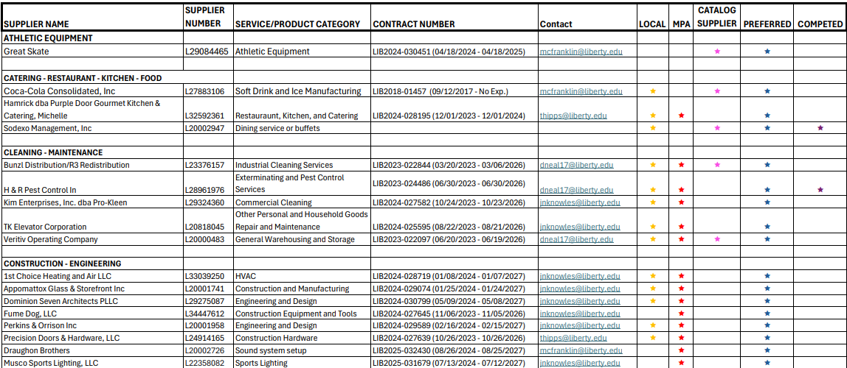
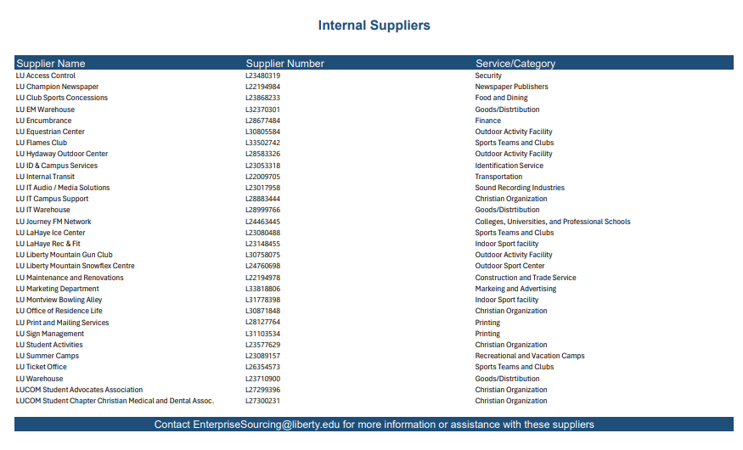
What’s new in Enterprise Sourcing ?

Slide 15
Sourcing Module Benefits!
Efficiency: The BuyLU Sourcing Module helps automate many manual tasks, reducing administrative burdens and speeding up the purchase process.
Improved Transparency – By providing visibility into the entire procurement process from supplier selection to contract management as needed, enabling better decision-making.
Cost Savings – Delivers an estimated 6–10% in savings through competitive bidding, enhanced negotiation leverage, performance-based supplier management, and data-driven information.
Better Collaboration – Supports centralized communication, real-time updates, automated workflows, and improved coordination across departments and with suppliers, all within the platform.
5. Stronger Compliance - Ensures adherence to policies through standardized processes, audit trails, supplier qualification, and policy enforcement.

Slide 16
How to create a request for a sourcing event

Slide 19
Award Scenario
Supplier 1
Supplier 2
Supplier 3
Supplier 4
Supplier 3
Supplier 1
Supplier 3
Supplier 2
Supplier 4
Supplier 3

Slide 20
MBUs by Enterprise Sourcing Analyst

Slide 21
Technology Services
2025 Spring Training
Procurement & Payment Services

Slide 22
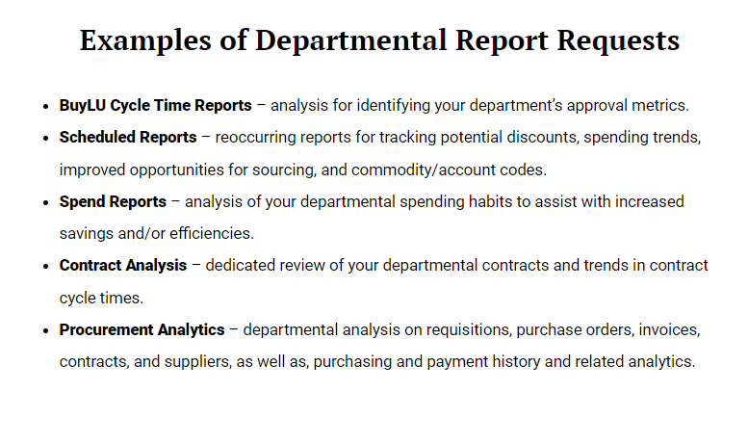
Analytics & Reporting
https://www.liberty.edu/finance-admin/procurement/purchase-and-contract-reporting/

Slide 23
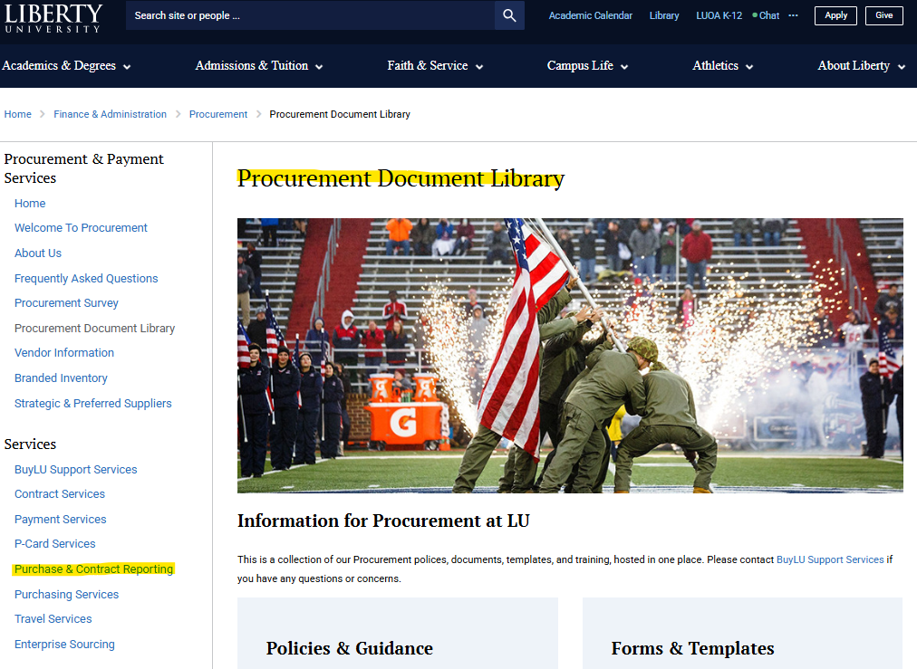
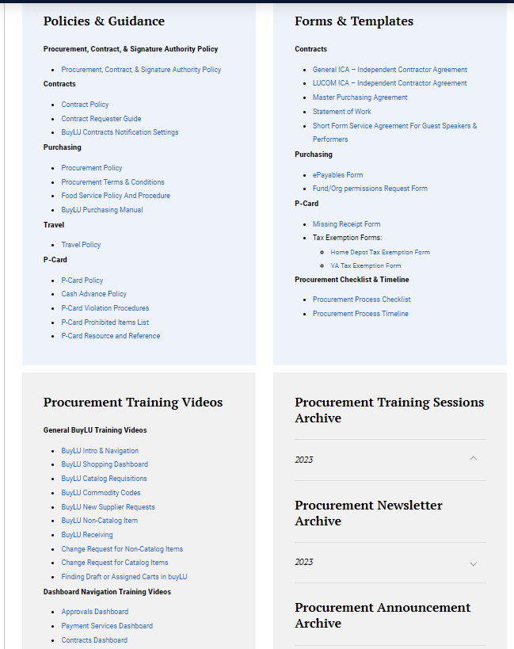
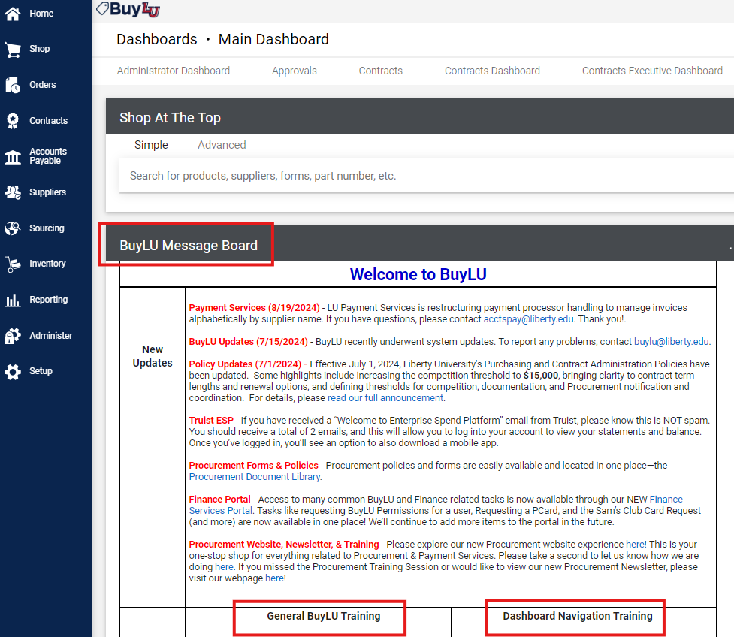
Procurement Training, Communications, & Reporting Guidance
Procurement Website
Announcements
Previous Training Sessions
Document Library
BuyLU Message Board
Announcements
Training videos and documentation
Procurement Newsletter
Announcements
Upcoming Training Schedule
Helpful Reports
Navigation
Helpful reports for your department

Slide 24
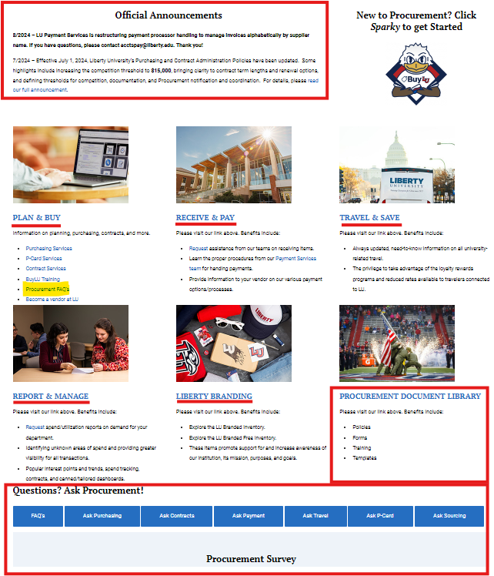
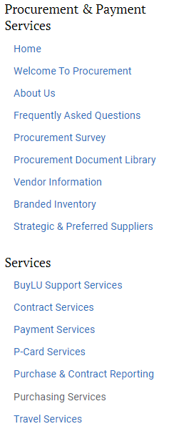
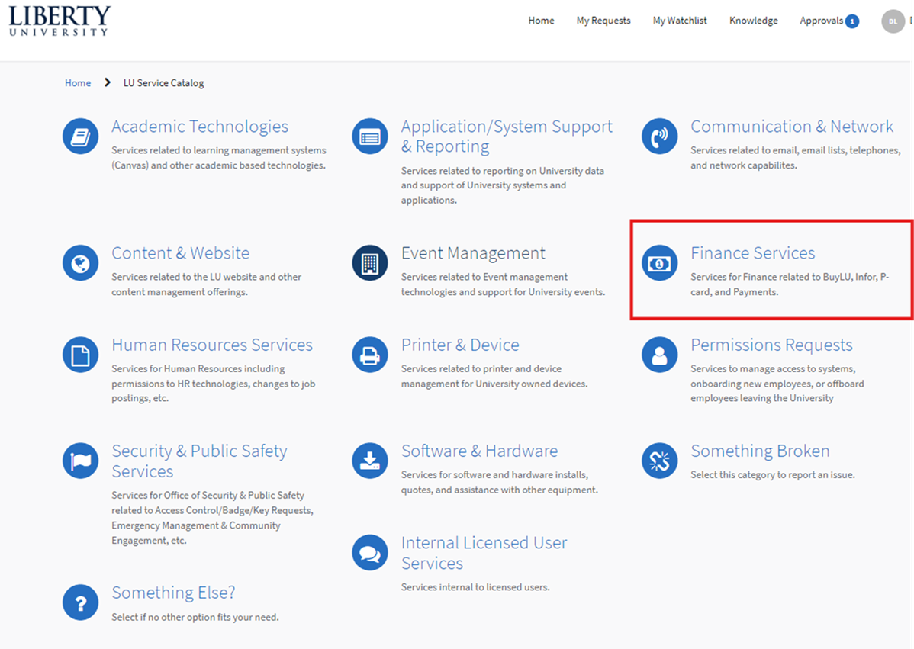
HELP – Where is it?
Procurement Website
Finance ServiceNow Portal
https://liberty.service-now.com
BuyLU Permissions
Approver Changes
Sam’s Card Reservations
P-Card Services
BuyLU Report Requests
Finance Support Contacts
Supplier Scorecard Request
www.liberty.edu/procurement
Announcements
Menu links
FAQs
Document Library
Procurement Team Services
Survey
Report Requests
Finance Support Contact Info

Slide 25
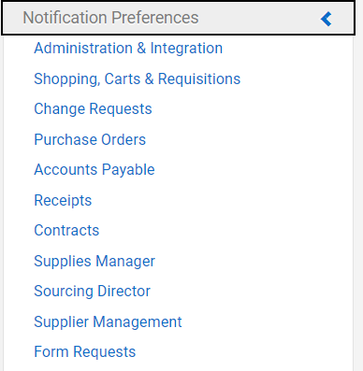
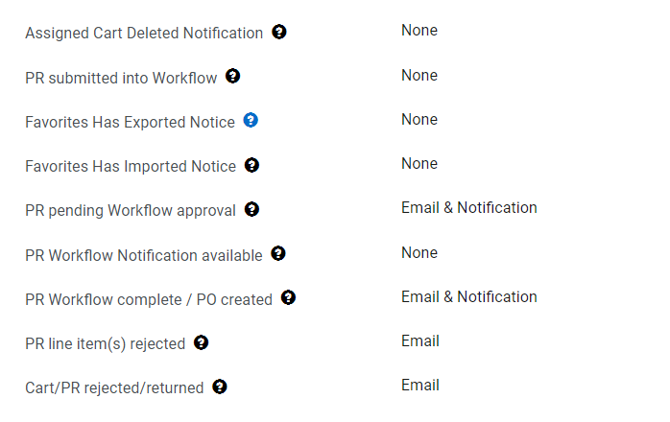
Update your Notification Preferences
Click the in the top right of BuyLU
Click the “Notification Preferences” section.
For each section, click at the top right to edit each type of notification.
You can select email, notification, or email & notification for each item.
Click the “?” for a description of the notification type.

Slide 26
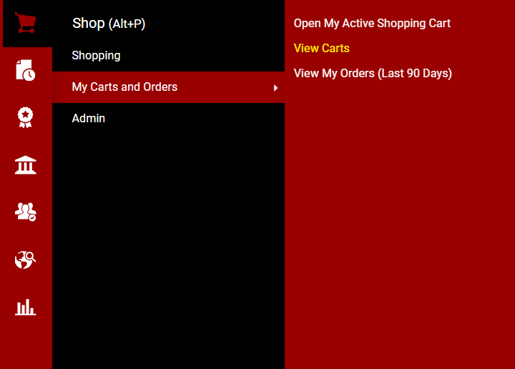
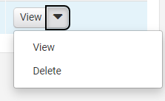
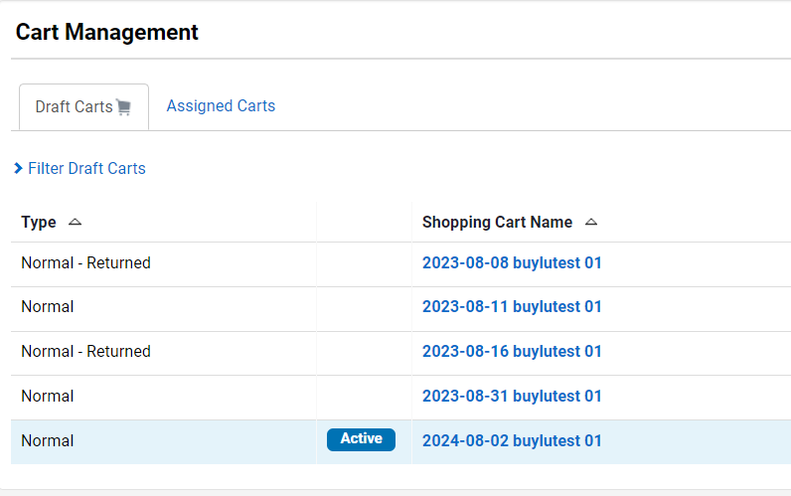
View My Order Info
Under the “Shop” section
My Carts and Orders
View Carts
You can view your own draft carts and carts assigned to you.
To delete a cart, click the down arrow on that line and select “delete”
On the Shopping Dashboard, scroll down to the bottom to view:
My Draft Carts
My approvals
My Requisitions
My Purchase Orders
My Open Purchase Orders

Slide 27
Sparky Says to Remember:
Do
Don’t
- Do not change FOAPALs on change requests.
- Do not submit requisitions without documentation.
- Do not submit a change request for a punch-out catalog order.
- Do not submit a supplier request if there is an existing profile for the supplier in BuyLU. Be sure to search for a supplier in BuyLU first.
-Check all dates on BuyLU requisitions & change requests to ensure they are current and accurate. (Transaction date = current date)
- Use the Finance portal in ServiceNow to alert Budget in advance of Financial approvers who will be temporarily absent for vacations or family leave to avoid last-minute urgent needs to acquire approvals.
- Ask suppliers you would like to purchase from to register in LU’s supplier portal. Contact suppliermanagement@liberty.edu for more information.
- Ensure your department’s financial approvers and submitters (Requestors) are different users.

Slide 28
Supplier Portal Registration Initiative
Starting 7/1/2025 all BuyLU suppliers will be required to register through the supplier portal.
At the beginning of the fiscal year supplier requests will default to “Invite Supplier to Register in Portal”.
If you have any questions or concerns, please contact suppliermanagement@liberty.edu

Slide 29
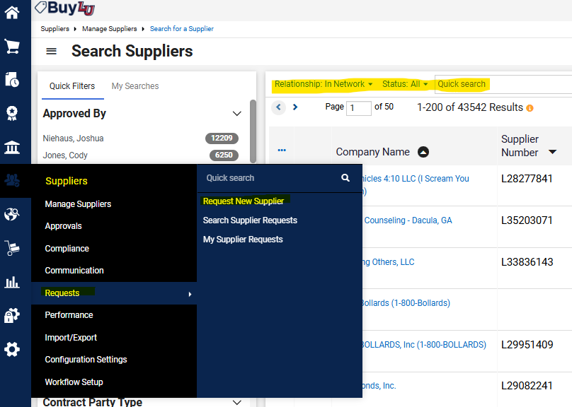
Supplier Searches & Requests in BuyLU

Slide 30
Contact Us
Purchasing Services
procurement@liberty.edu
(434) 592-3012
Enterprise Sourcing
enterprisesourcing@liberty.edu
(434) 592-5058
Contract Services
contracts@liberty.edu
(434) 582-7839
Payment Services
acctspay@liberty.edu
(434) 592-3166
P-Card Services
pcard@liberty.edu
(434) 582-2266
Travel Services
travel@liberty.edu
(434) 582-8760
Technology Services
BuyLU@liberty.edu
BuyLUReporting@liberty.edu
SupplierManagement@liberty.edu

