Slide 1
PURCHASING SERVICES
2024 Fall Training
Procurement & Payment Services
October 15, 2024

Slide 2
Purchasing Services
Order Competition Status Selections
Product Description Dates
Change Request Fields
Non-Employee Travel Reimbursement Form
Locating Purchasing Training Videos
Individual Training Sessions
FY25 Stats

Slide 3
Importance of Competition
Results in 8-17% savings
Ensures quality, price, and performance standards are met
Expands the vendor pool
Leads to better pricing, terms, and transparency
Reduces dependency on single supplier

Slide 4
The Order Competition Status selections are important for accurate reporting.
Purchase 15k or less (branded items <1k)
Competed
Justified
Exempt

Slide 5
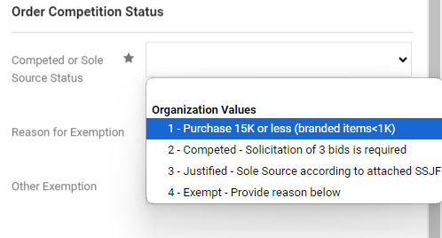
Purchase 15k or less (branded items <1k)
Purchase is 15k or less even if it is included on the list of exemptions
LU branded items under 1k

Slide 6
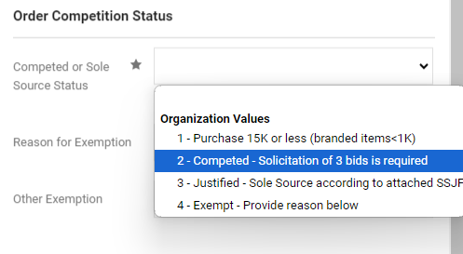
Competed – Solicitation of 3 bids is required
Competed purchases only (typically purchases >15k)
Bid Matrix Form is required

Slide 7
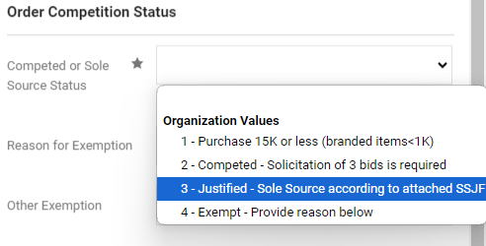
Justified – Sole Source according to attached SSJF
Sole source purchases
Sole Source Justification Form is required

Slide 8
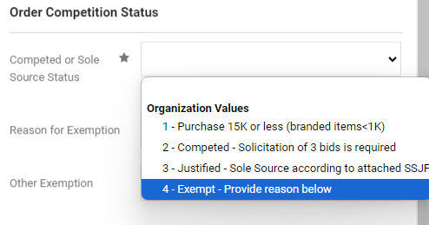
Exempt – Provide reason below
Purchases over 15k that are exempt per the Purchasing Policy
Reason for Exemption is required

Slide 9
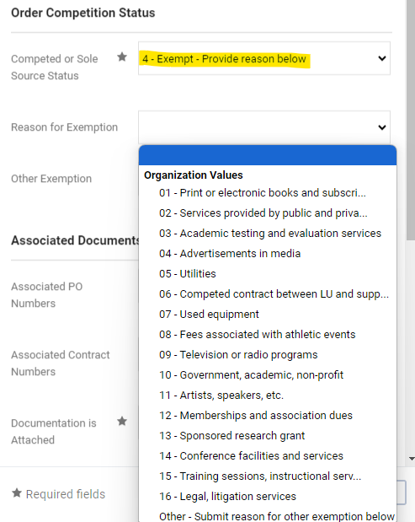
Reason for Exemption
Reason for Exemption should be selected based on the Purchasing Policy
The “Other” value may be selected if the reason is not listed. This will be reviewed by your buyer.

Slide 10
Product Description
Include dates in the product description field.
Contract term
Study Abroad date range
Trip date
Membership term
Event date
10

Slide 12
Change Request Reason
Include the original PO total, new PO total, and reason for change.

Slide 13
Change Request
When the quantity needs to change on a specific line, enter the new quantity needed.
Include the reason for the change in the Internal Note on that line.

Slide 14
New Non-Employee Travel Reimbursement Form
Form is in the Procurement Document Library under Travel.
Non-Employee
Reimbursing for travel only
Interview candidates, recruits, speakers/judges only receiving travel reimbursements
No other compensation
Attached to requisition
Receipts of actual expenses after travel

Slide 15
Non-Employee Travel Reimbursement Form

Slide 16
Purchasing Training
The BuyLU Home Page offers training videos to assist with the purchasing process.
Feel free to contact your buyer for individual purchase process training.

Slide 17
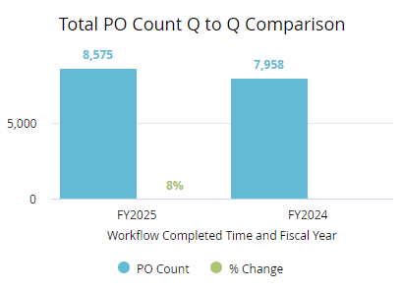
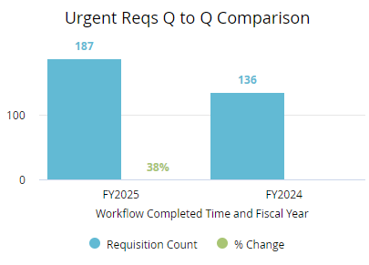
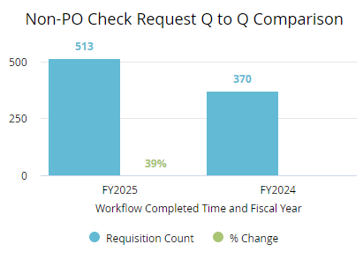
FY25 Stats
FY25 Stats

Slide 18
Coming soon… Unauthorized Commitment Procedure

Slide 19
Contact Us
Purchasing Services
procurement@liberty.edu
(434) 592-3012
Enterprise Sourcing
enterprisesourcing@liberty.edu
(434) 592-5058
Contract Services
contracts@liberty.edu
(434) 582-7839
Payment Services
acctspay@liberty.edu
(434) 592-3166
P-Card Services
pcard@liberty.edu
(434) 582-2266
Travel Services
travel@liberty.edu
(434) 582-8760

Slide 20
Thank You Q&A

Slide 21
Procurement Planning Timeline
Supplier
Typical processing time: 1-3 business days
Supplier Request Submitted
Supplier Registration
Review/Approvals
Supplier Activated
Contracts
Typical processing time: 30+ business days
Contract Request Submitted
Contract Terms Reviewed & Negotiated
Contract Approvals & Signature
Contract Executed
Historically, they haven’t been close to warrant action.
Purchasing
Typical processing time: 1-3 business days
Requisition Submitted
Approvals
Requisition Processed
Purchase Order Distributed
Invoicing
Typical processing time: 1-3 business days
Invoice
Created
Approvals
PO, Receipt, and Invoice Matched
Payment Distributed
Timeline does not include financial approvals.
Urgent requisitions - please notify approvers.

Slide 22
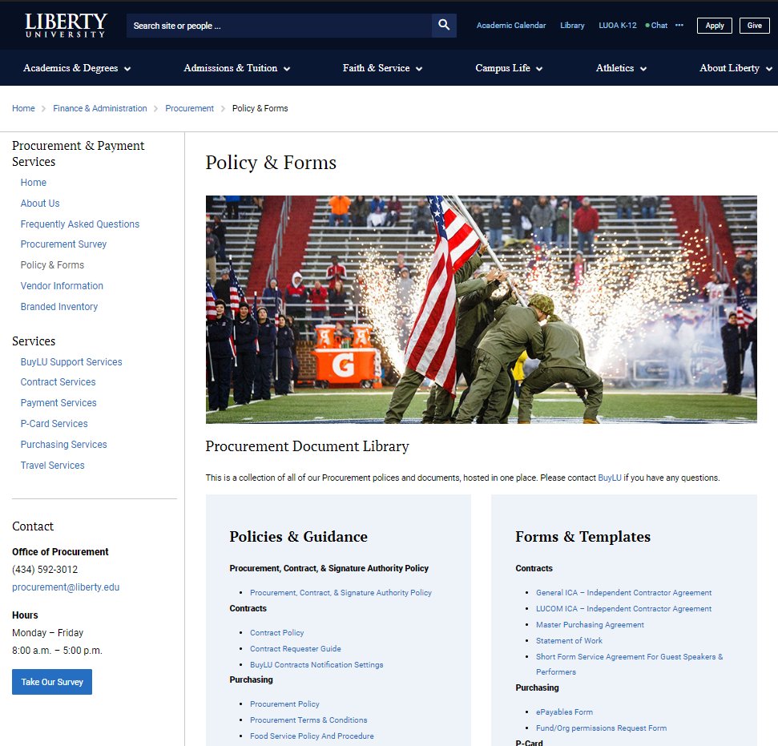
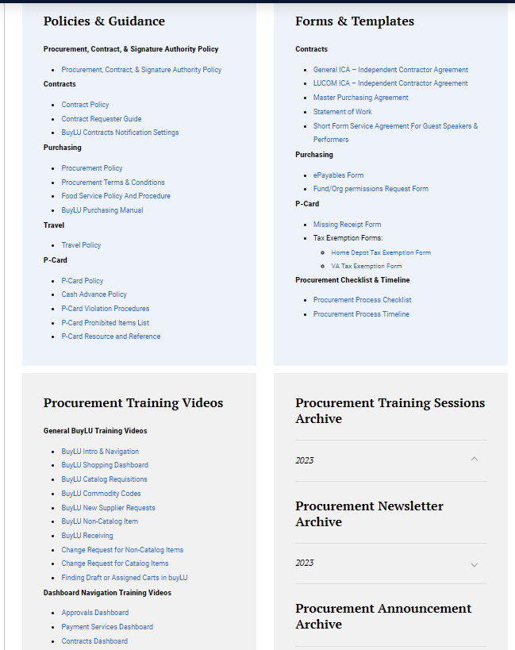
Procurement Training & Resources
Procurement Website
Training Videos
Document Library
Procurement Training Month – April 2024
Training schedule to be posted on Procurement website
Newsletter announcement

Slide 24
Procurement Planning Checklist

Slide 25
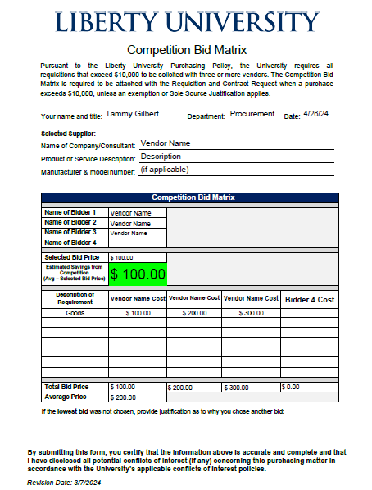
Competition Bid Matrix Form Standardizes documentation of competition results Calculates and highlights cost savings or additional cost Justification if higher bid is selected

Slide 26
FY25 Stats
23,626 purchase orders -18% increase
1,362 non-PO check requests – 4% increase
Violation of Board of Trustees Signature Policy by authorizing use of University funds without a purchase order
387 urgent requisitions (higher than FY23)
10% cost savings in FY24 beginning 9/11
Average cost savings 8 – 17%

