Slide 1
PURCHASING POLICY
2024 Summer Training
Procurement & Payment Services
July 16, 2024
Notes:
Hidden Sparkys?

Slide 2
Authority
Pursuant to the Procurement, Contract, and Signature Authority Policy (“Procurement Policy”), the President and Chief Financial Officer of the University delegated contracting and procurement administration authority to the Chief Procurement Administrator (“CPA”). The CPA manages the University’s Procurement & Payment Services Department (“Procurement”) in accordance with the Procurement Policy. The CPA and Procurement are responsible for enforcing this Purchasing Policy “Policy.”

Slide 3
Authority
No employee of the University is empowered to incur or make another party incur any obligation or make any commitment on behalf of the University for the purchasing of goods or services, verbal or written, except as provided under this Policy or as delegated by the President and/or CFO.

Slide 4
Determination of Needs
Consider the following prior to making a purchase:
Timing – sourcing, supplier registration, contract review, conditional reviews, approval lead times, and purchase process.
Requirements - Contract/requisition should represent the entirety of the projects scope of work or product.
Market Research is necessary to ensure competitive pricing. The extent will vary depending on the complexity of the purchase.

Slide 5
Determination of Needs
Check BuyLU first to see if your products are available through a BuyLU catalog. This offers a quick and efficient way to find what you need at the best overall value to the University. Competitive bids are required on purchases over 15k.
Ask vendors about educational discounts, rebates, and warranties.
Coordinate with other stakeholders when projects involve their department (example – Marketing for use of the LU brands)

Slide 6
Supplier Management
1. The University strives to conduct business with the best-qualified suppliers that meet the needs and objectives of the University. It is equally important that Liberty University maintains a trusted and broad supplier base to ensure a competitive environment to facilitate the best prices and performance.
2. The University uses BuyLU Vendor Relationship Manager to vet, approve and manage suppliers. This system allows the University to comply with state and federal statutes and ensure we conduct business with suppliers that maintain the highest standards of conduct and ethics.
3. Departments have a unique role in maintaining this environment through the course of day-to-day business, market research, soliciting for goods and services, and overseeing performance. At the pinnacle of this role, it is imperative to engage with suppliers in a fair and responsible way, safeguarding proprietary and pricing information being of utmost importance.

Slide 7
Bid Solicitation
Acquisition of goods or services will be by competition.
Sole Source purchases must follow the Sole Source Policy.
Notify Procurement of purchases over $100k via email to enterprisesourcing@liberty.edu
Solicit the widest number of capable suppliers, a
minimum of 3

Slide 8
Bid Solicitation
Bid communication should remain confidential.
Supplier pricing or proprietary information must not be shared with third parties.
Evaluation is based on best value to the University.
(Price, operational capabilities, quality, past performance, risk)
Identical purchases up to $100k that were competitively bid within the previous 12 months (when awarded to the lowest competitive bidder) can avoid rebidding by reusing that same supplier and pricing.

Slide 9
Bid Solicitation
Engage Legal Affairs for contracts that involve legal or regulatory compliance issues.
Engage Risk Management for COI requirements.

Slide 10
Bid Matrix Form

Slide 11
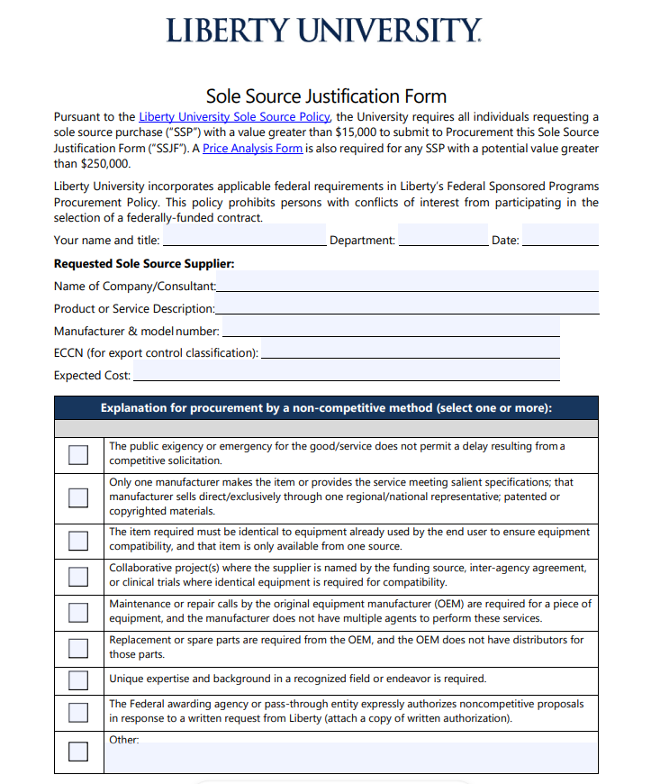
Sole Source Justification Form

Slide 12
Sourcing Requests
COMING SOON…

Slide 13
Purchasing Thresholds
Up to 1,000 branded items
P-Card, licensed supplier
Greater than 1,000 branded items
BuyLU, licensed supplier, 3 competitive bids
Up to 2,500
P-Card within P-Card Policy
Up to 15,000
Competitive bids are encouraged, not required
Greater than 15,000 up to 50,000
Solicitation from at least 3 capable suppliers, Bid Matrix Form
Greater than 50,000 up to 100,000
Use of Procurement approved template for RFQ’s or RFP’s
Greater than 100,000 up to 250,000
Procurement must be notified by email prior to sending solicitation
Greater than 250,000
Procurement must be notified and included in the acquisition strategy, solicitation, and award process.

Slide 14
Highlights
The competition threshold has been changed from $10,000 to $15,000.
Solicitation for bids from a minimum of three (3) capable suppliers that can provide comparable products or services is required on all purchases greater than $15,000.
A Competition Bid Matrix Form is required for all competed purchases.

Slide 15
Questions?
QUESTIONS?
QUESTIONS?

