Slide 1
PAYMENT SERVICES
2024 Fall Training
Procurement & Payment Services
October 10, 2024
Notes:
Hidden Sparkys?

Slide 2
INTRODUCTION
Procurement & Payment Services is the central hub to meet university purchasing, contract management, payment, and travel needs. With a focus on customer engagement, we aim to create value through professional service, transparency, and university buying power. We uphold the highest standards of ethics and integrity and are committed to mission accomplishment for Liberty University!

Slide 3
Discuss receipt creating/correction
Determining if an invoice is paid
Importance of invoices that are marked as P-Card
Payment Services
3

Slide 4
Discuss Receipt Creating/Correction
What are they? Signifies that the product has been received and is acceptable, or that the service has been completed and is acceptable.
Why are they important? It indicates that the vendor has fulfilled the order and the invoice is cleared for payment.
Why corrections might be needed:
Receipt date inaccuracies: The receipt date must accurately reflect when the product or service was accepted and deemed acceptable. This signals to PS which month the expense should be recognized, even if the invoice has not yet been processed. This ensures that liabilities are recorded in the correct period for reporting purposes.
Mismatch between receipt amount and invoice: If the receipt amount does not match the invoice, it signifies that the invoice should not be paid. This indicates that the work the vendor expects to be compensated for is not what LU actually received. (Over Receiving can result in future invoices on the P0 paying out before product/serviced received)

Slide 5
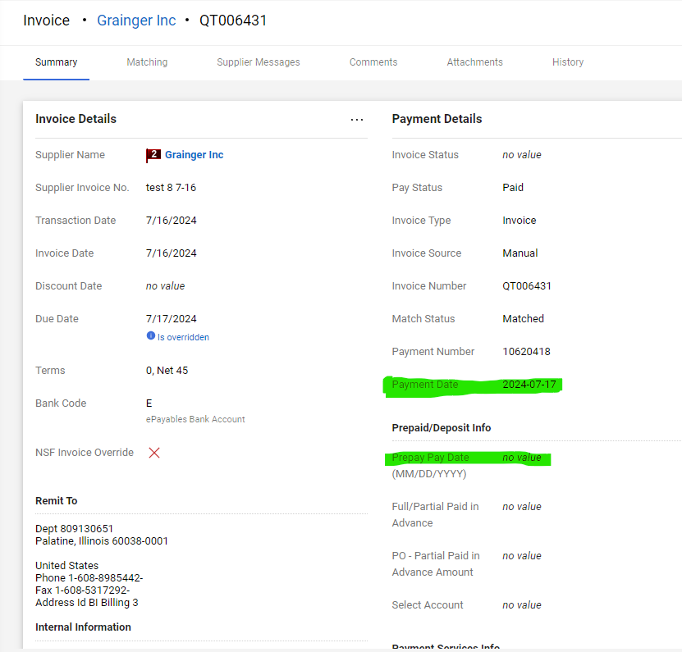
Determining if an invoice is paid
Notes:
BuyLU has a few areas to determine if an invoice has been paid. On the P0 you look at payment status
Or if payment status doesn’t show paid but Pre/Depos has a date then you can utilize that date as the ‘pay date’ (good thing to note is ‘complete’ green bar) . As always reach out with any questions

Slide 6
Importance of invoices that are marked as P-Card
Invoices marked as "pcard" or with an individual's name on the PO line, or an undetermined PO in BuyLU, are key pieces of information that PS uses to determine if purchase was potentially planned to be paid via pcard.
If the PO is undetermined and the vendor is requesting payment status, PS attempts to identify the department the invoice might belong to. If the vendor has reached out multiple times and PS is unable to determine the owner, multiple departments may be contacted about the same invoice.
If the invoice is to be paid with a Purchase Order, the vendor should not proceed with any work until they have received the PO number to include on their invoice. Purchase Order numbers are required on all invoices that PS processes (refer to the contract’s policy).
In the case of an emergency purchase made without a Purchase Order, please refer to the Purchasing Policy for the conditions required to request an emergency purchase justification. If it is not an emergency and payment is not allowed via pcard according to the Pcard policy, a non-PO check request must be submitted. This is against policy and will be noted. No special terms are allowed on non-PO check requests. Payment will be processed according to LU’s default payment terms (Check: Net 45, ACH: Net 40, or vCard: Net 10).

Slide 7
Thank You Q&A

Slide 8
Contact Us
Purchasing Services
procurement@liberty.edu
(434) 592-3012
Enterprise Sourcing
enterprisesourcing@liberty.edu
(434) 592-5058
Contract Services
contracts@liberty.edu
(434) 582-7839
Payment Services
acctspay@liberty.edu
(434) 592-3166
P-Card Services
pcard@liberty.edu
(434) 582-2266
Travel Services
travel@liberty.edu
(434) 582-8760
Technology Services
BuyLU@liberty.edu
BuyLUReporting@liberty.edu
SupplierManagement@liberty.edu

Slide 9
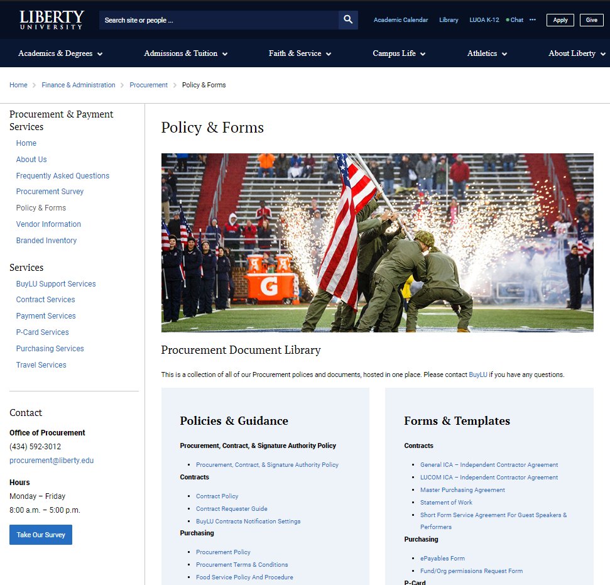
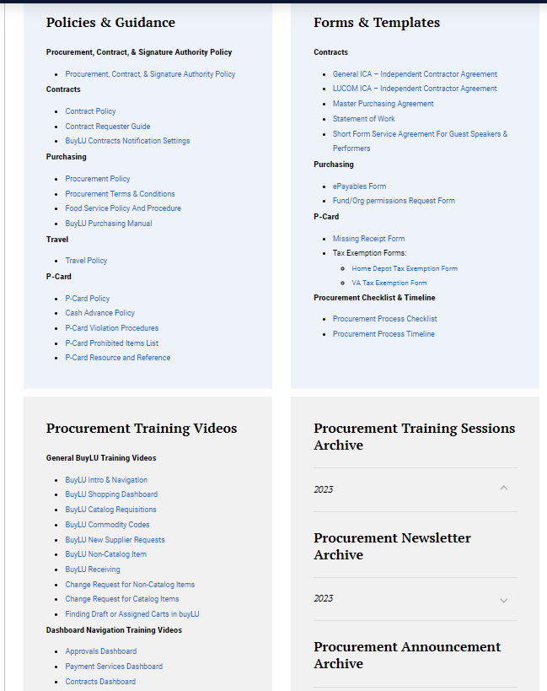
Procurement Training & Resources
Procurement Website
Training Videos
Document Library
Procurement Training Month – April 2024
Training schedule to be posted on Procurement website
Newsletter announcement

Slide 10
Procurement Planning Timeline
Supplier
Typical processing time: 1-3 business days
Supplier Request Submitted
Supplier Registration
Review/Approvals
Supplier Activated
Contracts
Typical processing time: 30+ business days
Contract Request Submitted
Contract Terms Reviewed & Negotiated
Contract Approvals & Signature
Contract Executed
Historically, they haven’t been close to warrant action.
Purchasing
Typical processing time: 1-3 business days
Requisition Submitted
Approvals
Requisition Processed
Purchase Order Distributed
Invoicing
Typical processing time: 1-3 business days
Invoice
Created
Approvals
PO, Receipt, and Invoice Matched
Payment Distributed

Slide 12
Procurement Planning Checklist

