Slide 1
P-Card & Travel Services
2024 Fall Training
Procurement & Payment Services
October 17, 2024
Notes:
Hidden Sparkys?

Slide 2
P-Card Services
P-Card – What’s my balance?
How/where to check it
What information can you see
P-Card – What do you do?
Missing Receipt forms
Gift Incentive forms
P-Card – Fraud
What do you do?
What does P-Card Team do?
Demo
Check Balance on ESP
Find forms on P-Card Website

Slide 3
What’s my P-Card Balance?
All cardholders have access to the Truist online banking platform called ESP.
This allows you to log in and view your recent transactions, available credit, and any pending charges as well.
You can be made a delegate for someone to check their balance, obtain written approval from cardholder, and email pcard@liberty.edu.

Slide 4
P-Card – What do you do?
Visit the P-Card Website first – you will find a wealth of knowledge there! Such as:
Missing a receipt from your purchase? Missing Receipt Form (MRF)
Gifting something? Including any amount in gift cards: Gift Incentive Form (GIF)
How do I request a change to my limits/P-Card: There’s a link for that! Takes you right to the P-Card Application Suite.

Slide 5
P-Card Fraud
Continually keep watch on your transactions
See something, say something
You’ll need to call the bank (Truist) with your concern
I’ve called the bank, now what?
Complete the Fraud form on P-Card Website
Reconcile as fraud in Infor
Watch for credits from bank
What do you need when you call the bank?
Call from the cell number on file with your card
Have your full card number with you
Other details provided under fraud section on P-Card Website
How do I prevent fraud?
Be aware of the Prohibited shopping list
Do NOT save your card on any website or to your mobile wallet
Do NOT let anyone use your card – YOU are responsible for all transactions

Slide 6
Do’s and Don’ts for P-Card
Do
Use for travel expenses
Use for office needs not available via BuyLU
Make sure to ALWAYS have itemized receipt
Make sure to ALWAYS include roster for food purchases
Make sure to ALWAYS include business purpose for meals (that are not YouMatter)
Make sure to ALWAYS use Tax Exemption
Don’t
Pay for personal purchases
Split purchases over $2,500
Let others in office use your card
Store on any website/device
Wait to reconcile to the last minute
Hesitate to reach out to P-Card Office with questions

Slide 7
Live Example:
How to get to P-Card Website
From MyLU
From URL – liberty.edu/finance-admin/procurement/pcard/
Navigate P-Card Website
Forms available
- Missing Receipt Form
- Gift Incentive Form
- Fraud Report Form
Dealing with P-Card Fraud section
Should be done within 30 days to avoid penalties
Always H2000-60-Fraud – under Fraud expense type

Slide 8
A Few P-Card Stats
There are approximately 1,430 P-Cards across campus
Processed 196 requests concerning P-Card in 1Q FY25:
135 - Closing, replacements (fraud, lost, damaged), transaction limit changes, monthly limit changes
61 - New P-Card requests (not all approved)
In just the first quarter of FY25, there have been 5K ERs completed (containing about 20K transactions)
Of these, 231 transactions were found to be “rouge” from Amazon (not business), Venmo, Etsy, eBay, PayPal, Airbnb
Starting to be able to monitor late transactions more frequently – if you are past 90 days you are subject to having your P-Card suspended (email notifications will be sent)

Slide 9
Travel Services
Travel Requirements
Contracts
Spend Thresholds
Dos and Don’ts for Travel
Concur
Hotel Search
Adding to Itinerary
Is it Booked?

Slide 10
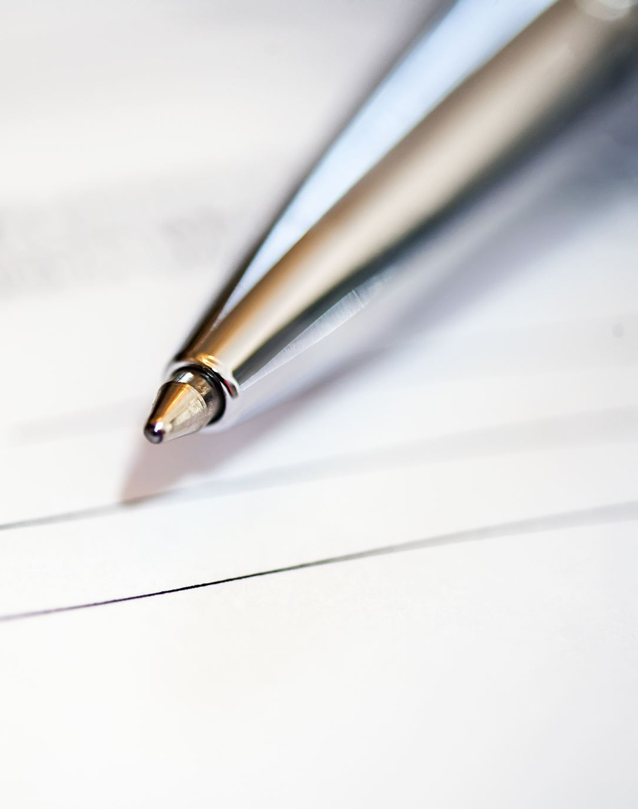
Travel Requirements
Contracts
Any document that requires a signature, must go through the BuyLU contracts process
For Travel contracts – please use the “Travel Contract Request Form” type when submitting a request for proper routing
Anthony Travel should be used for any contract that Liberty University will be paying for – excluding local contracts in which you will use our Travel Office.
Spend Thresholds (by Vendor – not Trip)
Under $2,500 should be placed on personal P-Card, or someone in department’s P-Card (within P-Card Policy)
$2,500+ should be placed on Travel P-Card.
- Notice to Travel Office, Pre-approval and Requisition with proper documentation need to be completed prior to trip.
- Proper receipts must be supplied to Travel Office within 15 days after trip for reconciliation purposes.

Slide 11
Do’s and Don’ts for Travel
Book on Concur
Compare Rental VS Personal Car pricing here
Don’t
Book directly on supplier site
Split payment to be able to put on P-Card*
Do
Use the new Travel Request Form for all needs that will be above P-Card limit and for group travel*
Sign a contract of any type (whether LU is paying or not)
Return rental car without refueling first
Request passenger vans through Travel Office

Slide 12
Concur
Important information about Concur:
Must complete profile upon log-in
Need to click through all pages until you reach the last one that says “finished!” or your trip is not booked
You are allowed to book personal travel on Concur and you can book for a guest as well
Non-refundable flights will provide a credit for future flight
We do not purchase basic economy
Updated Travel Policy has been made available on liberty.edu/finance-admin/procurement/travel/

Slide 13
A Few Travel Stats
Anthony Travel has saved the University almost $50k in just the first quarter of FY25 (this is why it is important to use Anthony Travel and Concur for all travel)
Fun fact: over FY24 Anthony travel saved the university approximately $275K – with about $80K of that just in unused tickets
Travel Requisitions:
Received 348 in Q1 – completely processed within 2.8 days (goal is 3 days)
Received 112 travel contracts in Q1 – completed process within 7.8 days (goal is 20 days or less)
Fun fact: Q4 of FY24 there were 53 contracts completed in 10 days avg

Slide 14
Thank You Q&A

Slide 15
Contact Us
Purchasing Services
procurement@liberty.edu
(434) 592-3012
Enterprise Sourcing
enterprisesourcing@liberty.edu
(434) 592-5058
Contract Services
contracts@liberty.edu
(434) 582-7839
Payment Services
acctspay@liberty.edu
(434) 592-3166
P-Card Services
pcard@liberty.edu
(434) 582-2266
Travel Services
travel@liberty.edu
(434) 582-8760
Technology Services
BuyLU@liberty.edu
BuyLUReporting@liberty.edu
SupplierManagement@liberty.edu

