Slide 1
ENTERPRISE SOURCING
2024 Fall Training
Procurement & Payment Services
October 14, 2024

Slide 2
Topics of Presentation
1. Sourcing Team Purpose 2. Accessing catalogs and usage 3. Shopping Dashboard 4. What’s New in Sourcing 5. Quick Overview of the New Sourcing Module
2
Notes:
Recreate slide to contact contact points
List of catalogs that don’t have tiles

Slide 3
Enterprise Sourcing can offer guidance for your sourcing needs
Centralizing sourcing efforts can improve compliance with requirements and standardize procurement practices, leading to greater efficiency and risk mitigation.
Experience researching Information for products and services in multiple portfolios.
Provide assistance with large or small projects and obtain quotes.
Aid in getting the best product and service for your department.
Whatever the need, we are here to help!

Slide 4
Catalog vs. Non-Catalog
Pros for Catalog vs. Non-Catalog Orders
Less manual entry
Able to search the catalogs for Suppliers, product information, pricing & availability
Commodity codes and product descriptions are provided
PO is automatically generated after financial approvals of the requisition and no buyer processing is required
Multiple quotes are still required for orders over $15,000 and Branding Purchases $1000 or more. Please reach out to your buyer for additional information.
4

Slide 5
Accessing Catalogs

Slide 6
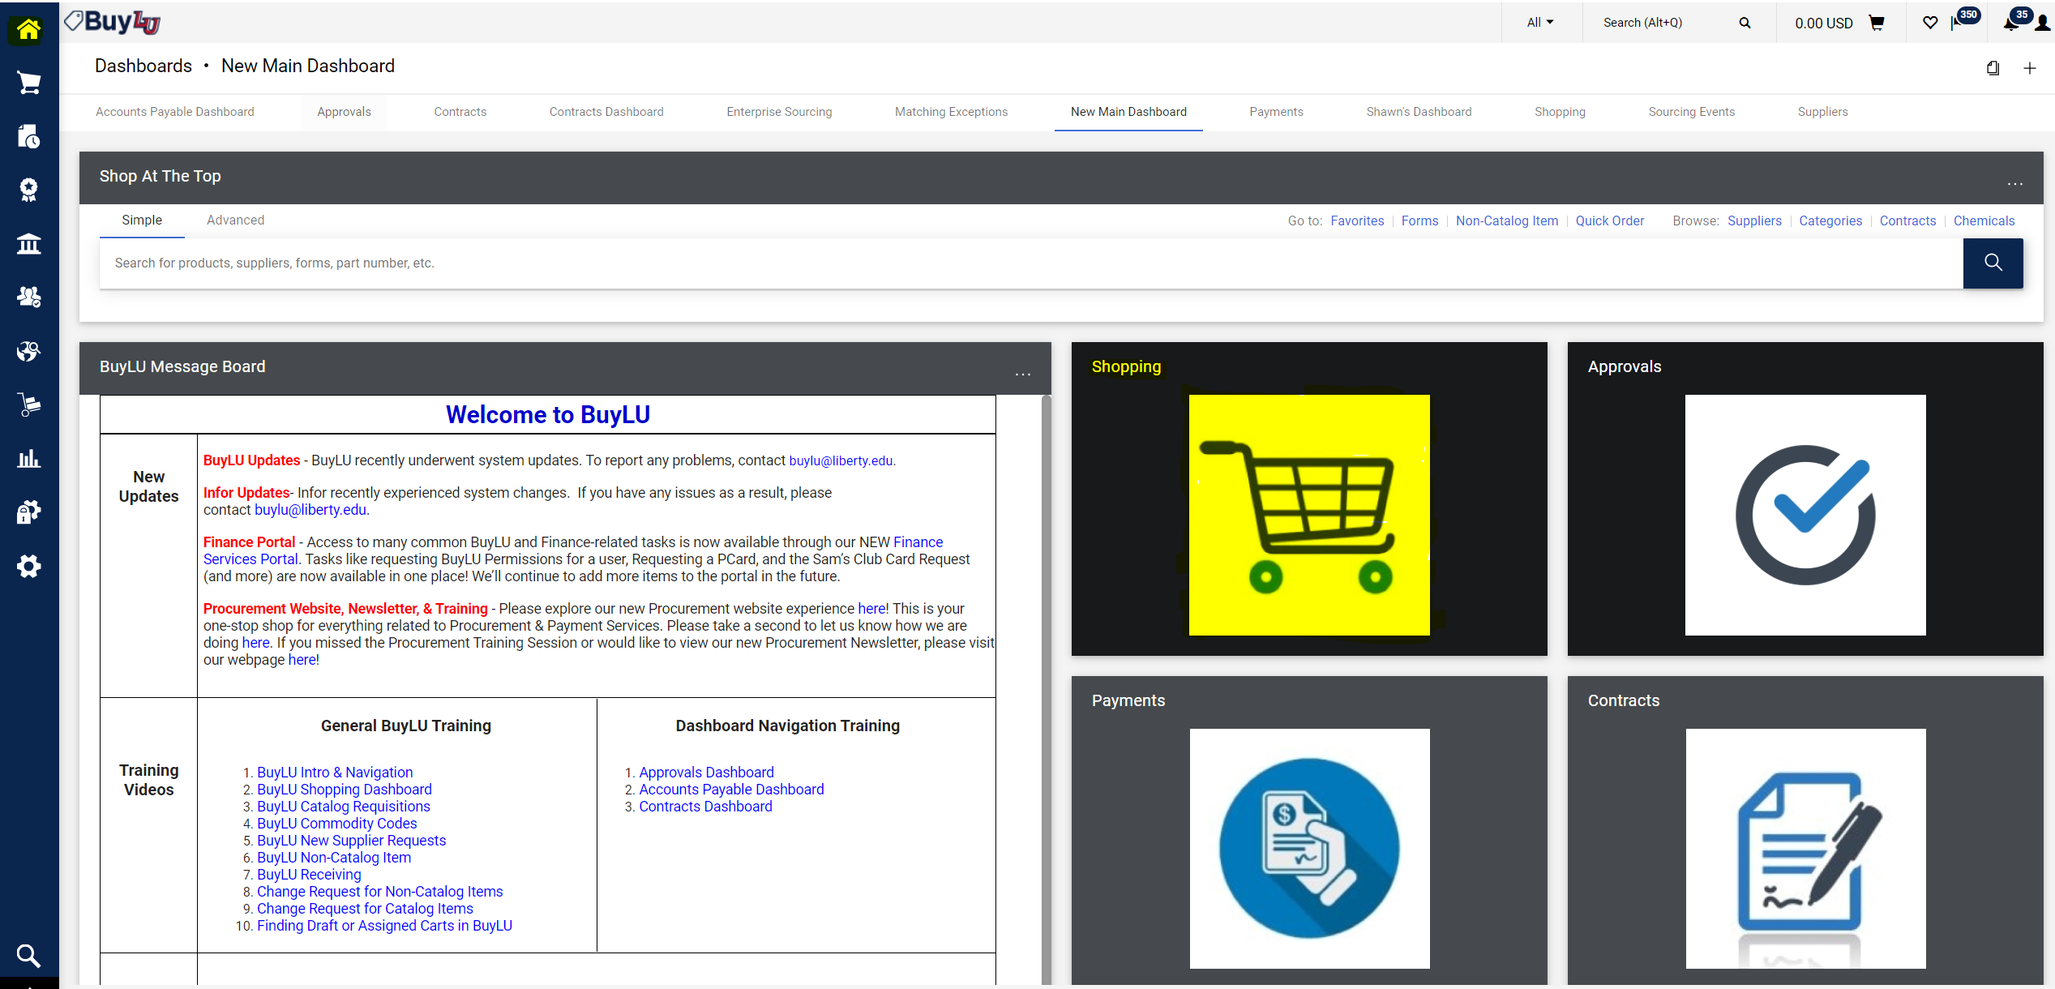

Slide 7
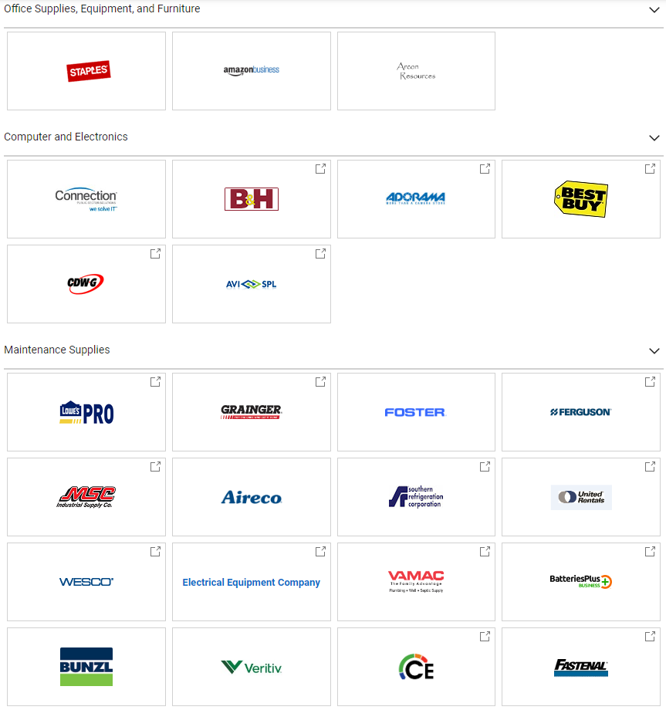
Catalogs Types
BuyLU Showcase/Punch Out/Hosted Catalog Tiles
Punch-out Catalog
Hosted Catalog
Self-Managed Catalog
7
Notes:
Delete?

Slide 8
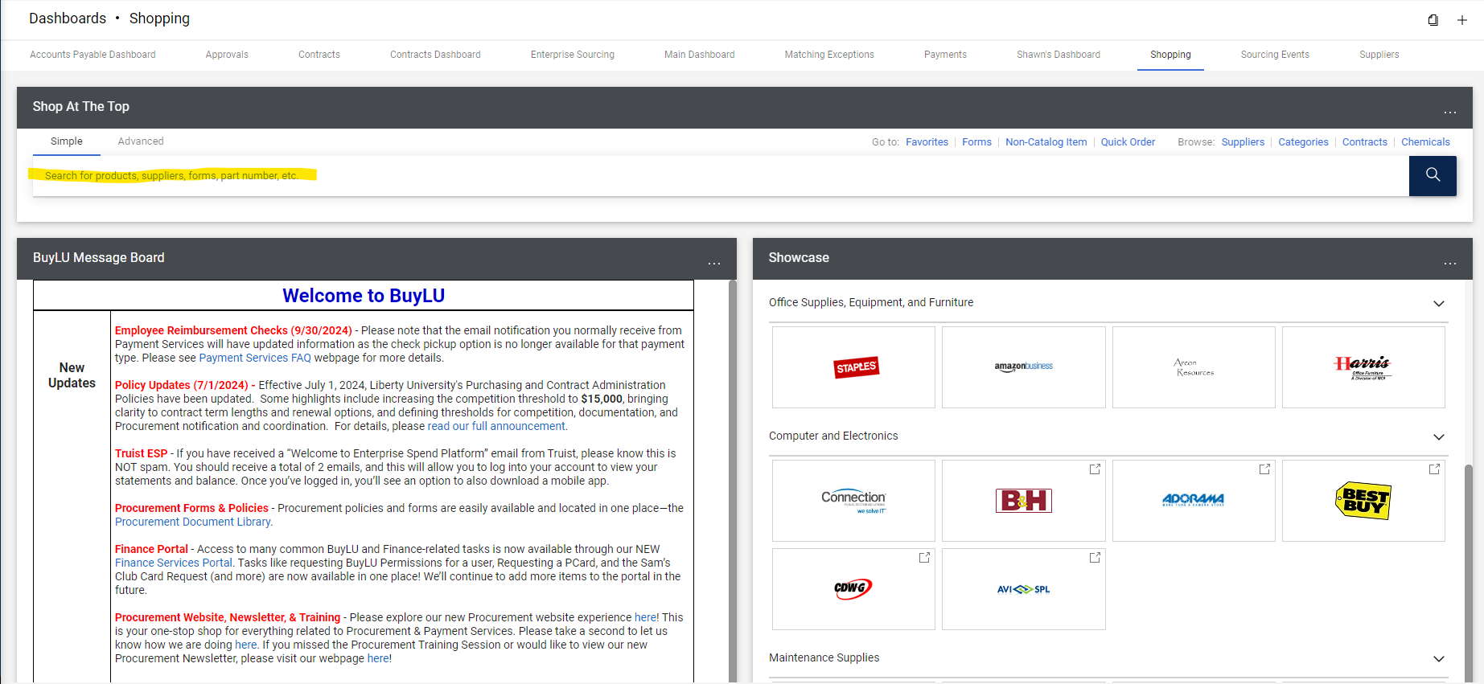
Shopping Dashboard

Slide 9
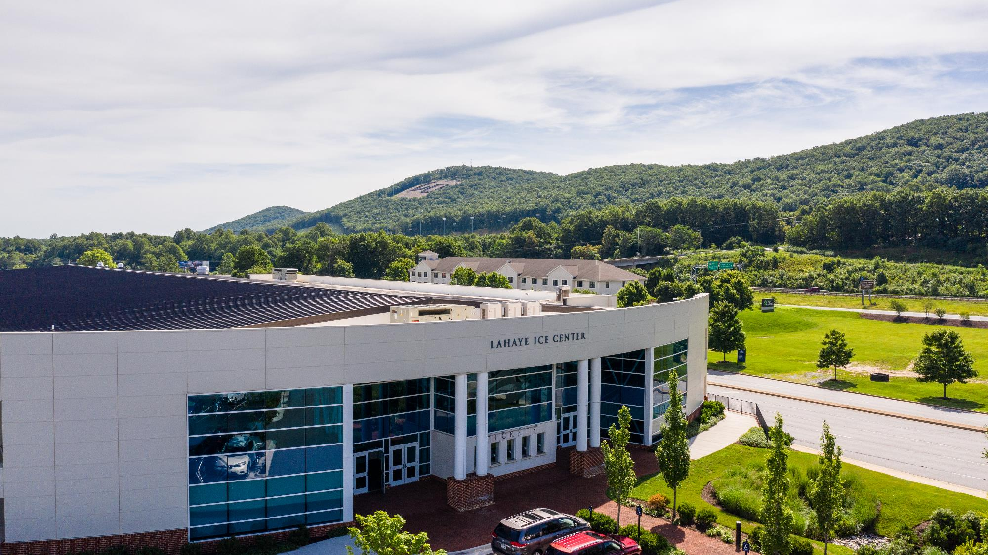

Slide 10
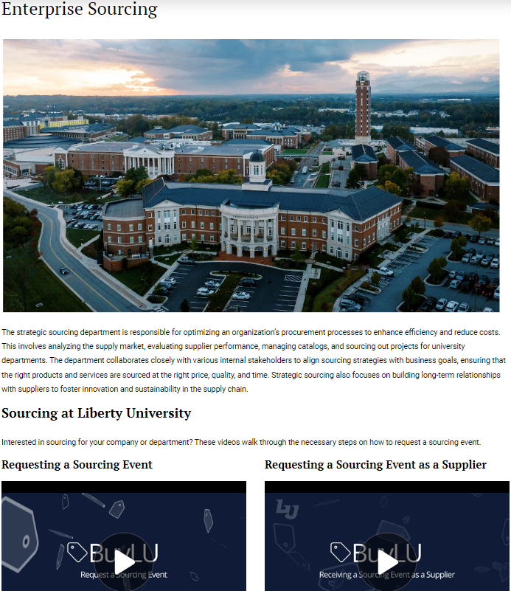
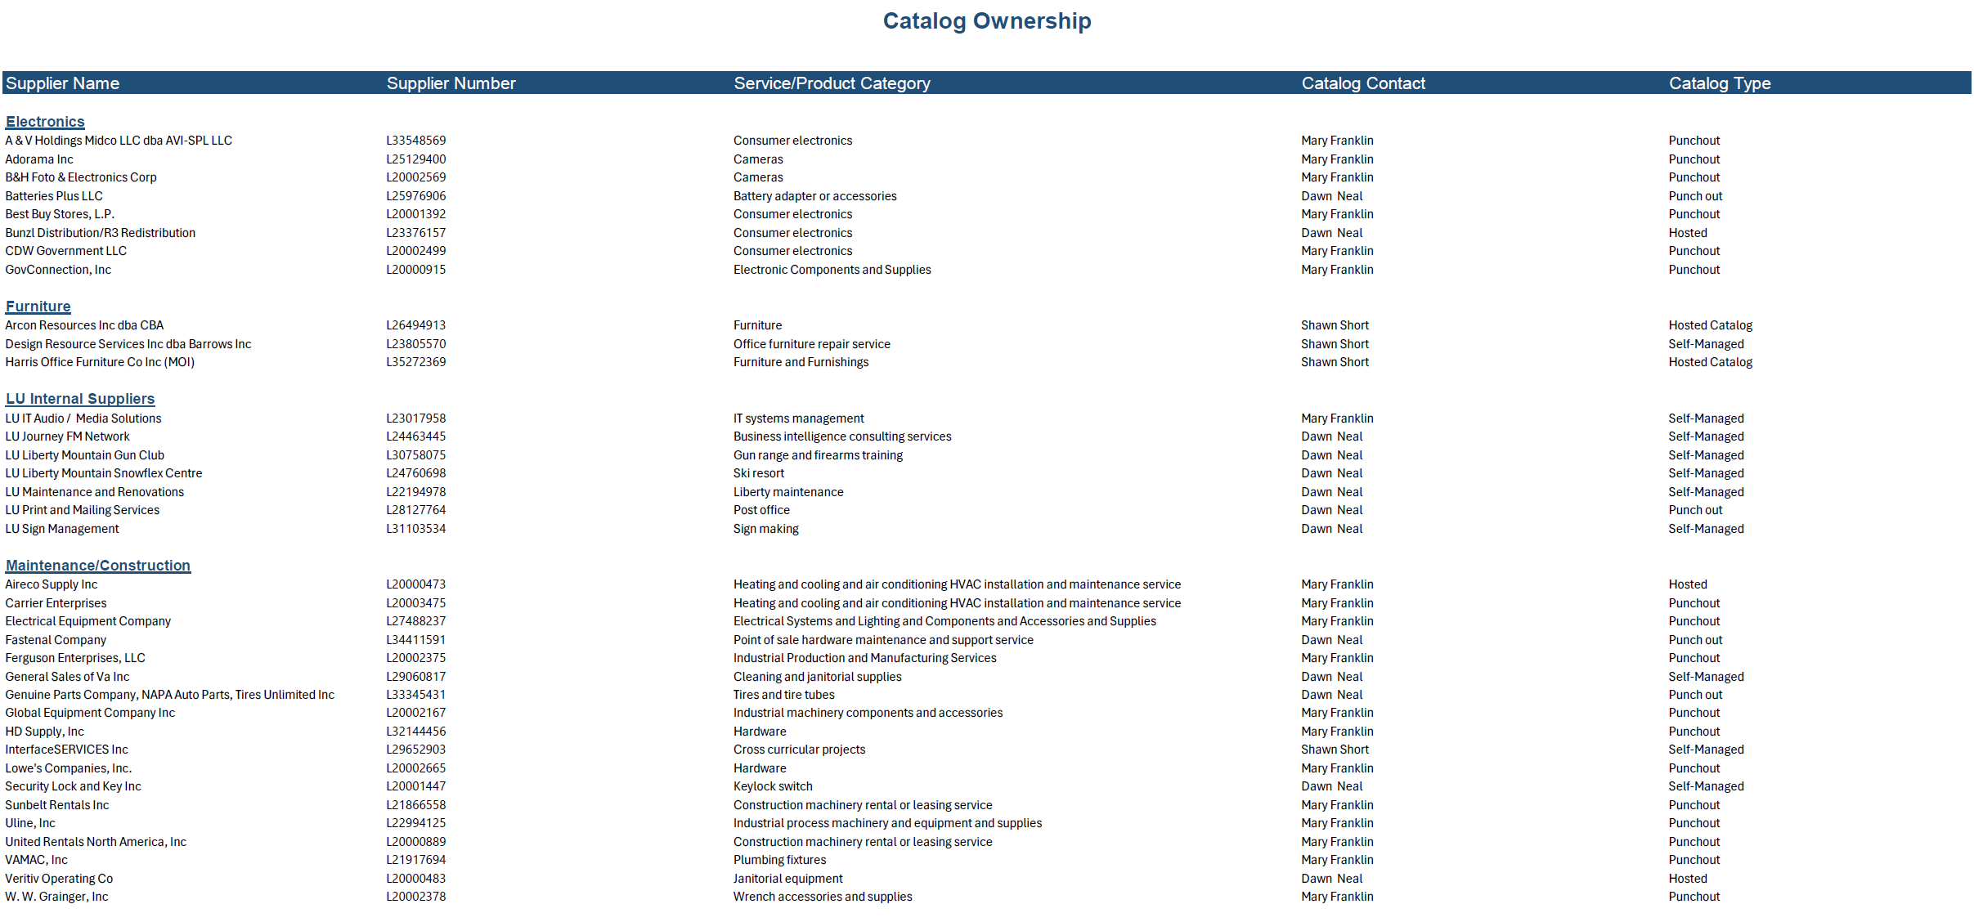
What’s new in Enterprise Sourcing ?
Notes:
Sourcing Module here?

Slide 11
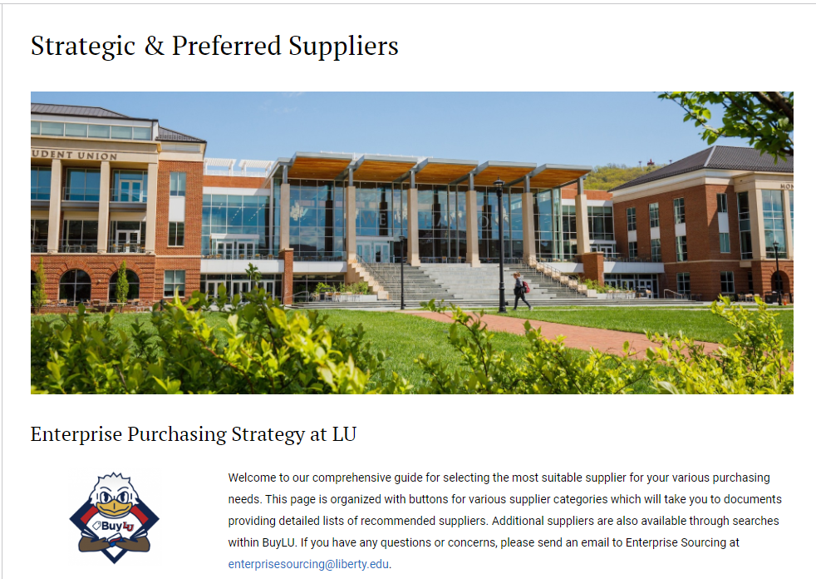
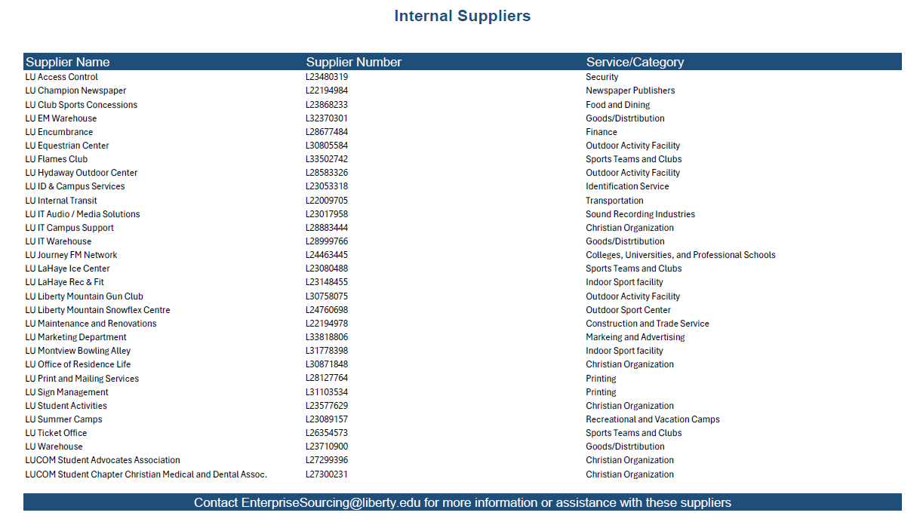
What’s new in Enterprise Sourcing Cont.

Slide 12
Sourcing Module
Streamlining Process
Improved Transparency
Improves Decision Making
Cost Savings
Better Collaboration
Compliance

Slide 13
Future Training Interest
Catalog Training
Sourcing Module Training

Slide 14
Thank You Q&A
Any Questions?

Slide 15
Contact Us
Purchasing Services
procurement@liberty.edu
(434) 592-3012
Enterprise Sourcing
enterprisesourcing@liberty.edu
(434) 592-5058
Contract Services
contracts@liberty.edu
(434) 582-7839
Payment Services
acctspay@liberty.edu
(434) 592-3166
P-Card Services
pcard@liberty.edu
(434) 582-2266
Travel Services
travel@liberty.edu
(434) 582-8760
Technology Services
BuyLU@liberty.edu
BuyLUReporting@liberty.edu
SupplierManagement@liberty.edu

