Slide 1
CONTRACT SERVICES
2024 Fall Training
Procurement & Payment Services
October 16, 2024

Slide 2
Contract Services
End of Calendar Year Guidance
Contract Requests
Documents to Attach to Contract Request
Contract Submission
Requestor Responsibilities
Term Limitations
Prioritization
Signature Policy
Timing & Coordination
Independent Contractor Agreement
Short Form Contracts
Supplier Scorecards

Slide 3
End of Calendar Year Guidance- Contracts
Deadline: November 1, 2024
All new Contract Review Requests and Renewal Requests should be submitted in BuyLU by November 1st to ensure successful contract completion prior to the end of the calendar year. Contracts will be worked in the order they are received and based on priority.
NOTE: Please keep in mind that there are two holidays during this timeframe where the University will be closed, so it is important to get your submissions in as soon as possible.

Slide 4
Contract Requests
When to submit a contract:
Any document with terms & conditions or a link to terms & conditions must be submitted in BuyLU
Submit contract request prior to requisition. A Contract Administrator will inform you when you can submit the requisition
Submit at least 30 days prior to need-by-date or contract start date
Departments submitting contracts with short review timelines, should proactively reach out to the Contract Services team to ensure a full understanding and impact of the requirement. Although emergency and unforeseen circumstances arise, routinely rushing through contracts can lead to additional costs, poor-performing suppliers, and risk to the University.

Slide 5
Documents to Attach to the Contract Request
Master Agreement (i.e. MPA, SOW, ICA, or any document with terms & conditions)
Supporting documentation (i.e. exhibits, quotes, Riders, drawings, emails, etc.)
Certificate of Insurance
For Sole Source:
Sole Source justification form
Over $250,000 will also require the Price Analysis Form
Competed Purchases/Services over $15,000
A competitive bid matrix
This Photo by Unknown Author is licensed under CC BY-SA

Slide 6
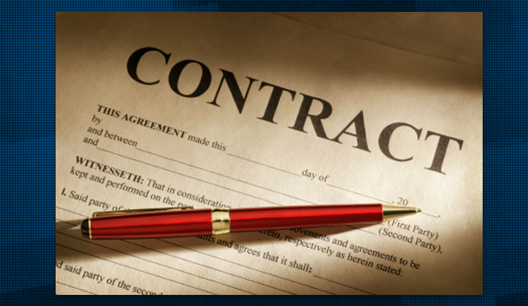
Contract Submission
A contract should only be submitted for “Approved” suppliers. If it is unknown whether a supplier is approved, please validate in the BuyLU Supplier Management module.
Renewals must be submitted for review at least 30 days prior to the need-by date or start date. If there is a Master Agreement (MPA, MSA, etc) in accordance with the renewal or quote, please make sure the Master Agreement is referenced on the quote as the governing terms.
The requestor and/or other department subject matter experts should be available to support negotiations and make department decisions regarding changes to requirements and/or risk. This is especially important when a Critical or High contract request is submitted.
Status and comments regarding the contract review process are available in BuyLU Contracts to facilitate the contract review process.
It is the department's responsibility to monitor the delivery of items or the performance of a contracted service. Departments may not ask the vendor to perform tasks not already part of the contract or purchase order, in essence obligating the University. This would be considered a violation of the Liberty University Signature Authority Policy.
If a change to a contract is required, departments should submit a request for modification in the BuyLU contracts module.

Slide 7
Requestor Responsibilities
The requesting department initiating the contract is responsible for reading the contract entirely and determining that:
Competition requirements have been met (see Purchasing Policy in Procurement Document Library)
The contract language is clear and consistent, and accurately reflects the current state of negotiations.
The contract meets programmatic requirements and the mission of the University.
The requirement does not duplicate capabilities already in existence and available within the University.

Slide 8
Requestor Responsibilities
The contract fully represents the entirety of the requirement; ill-defined scopes of work and incomplete contract language lead to scope creep and increase financial risk to the University.
The contract is fully funded. Contract requests will be returned to the requestor in BuyLU if there is no approved funding.
They can ensure compliance with the obligations the agreement places on the University.
They have consulted with all divisions or departments affected by the contract, and the contract terms have been approved by the appropriate department head.

Slide 9
Term Limitations
Term. The maximum allowable term for any contract (except for leases which may have longer terms) under the Board of Trustees Signature Authority Policy - including options for renewal – without requiring additional Board approvals, is five (5) years.
Long-term arrangements can provide for better pricing but can also limit University flexibility.
It is best practice to ensure that a multi-year contract includes a termination for convenience clause to provide the University with a way out of the contract prior to the end of the term.

Slide 10
Term Limitations
Re-compete. Proper planning should be considered when agreements are coming to the end of their term; a solicitation (re-compete) of these requirements is required unless renewal terms are stated in the original agreement. Renewals will not be permitted without competition unless an exception to competition applies.
Auto Renewal. Auto renewal terms are not acceptable. All renewals must be included in a contract as an option with a defined notification period. (E.g. “Liberty University shall have the option to renew for twelve (12) month successive terms with a 60-day prior written notice.”)

Slide 11
Prioritization- Critical
Assigned to those actions, regardless of dollar value, that if not processed efficiently and effectively would: (and/or)
Put at risk, life, health, or safety of the staff, faculty, or students.
Disrupt the critical function of the University or academic program(s); and/or
Endanger the preservation or protection of property.
Negatively impact the primary mission and/or reputation of the University – failure to meet publicized initiatives, timelines, etc.
Create a security risk based on data/privacy/network.
As directed by the Chief Procurement Administrator.

Slide 12
Prioritization- High
Assigned to those actions, regardless of dollar value, that if not processed efficiently and effectively would: (and/or)
Impact the execution of strategic goals/vision of Executive leadership – when expressly stated.
Degrade the execution of Division/Departmental goals and timelines -- when expressly stated.
Disrupt operations aligned to academic year, athletic seasons, or critical path projects.
As directed by the Chief Procurement Administrator.

Slide 13
Signature Policy
The Board of Trustees on April 16, 2021 gave specific individuals signature authority to sign and enter into contracts on behalf of the University:
The President
Chief Financial Officer
Designated Procurement & Payment Services personnel
Unless delegated in writing by the President or CFO, no one else is authorized to sign.
Notices to proceed (“NTP”) are in effect using a signature authority and are violations of the signature policy.
Please, do not sign any contract on behalf of Liberty University.
Students are not authorized to sign anything on behalf of the University.
Submit all contracts to the Contracts Team through BuyLU. Quotes with terms & conditions attached or linked also need to be reviewed by the Contracts Team.

Slide 14
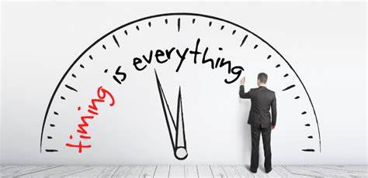
Timing & Coordination
All contracts exceeding $100,000 require a final signature by the CFO.
a. All Construction contracts require the review and approval of the CFO.
b. Contracts exceeding $1,000,000 require the approval of the President.
c. Contracts exceeding $2,000,000 require the approval of the President and the CFO.
d. Contracts exceeding $5,000,000 require the review and approval of the Board’s Budget and Finance Committee; approvals will be routed through the CFO for submission to the committee.

Slide 15
Timing & Coordination
Legal Affairs must review and approve the following contracts prior to submitting them for BOT, President and/or CFO approvals:
a. Contracts, renewals, or amendments exceeding $1,000,000.
b. All construction agreements regardless of value, except Legal Affairs approved templates.
It is the responsibility of the Department seeking to enter negotiations to contract with a supplier to coordinate with other stakeholders who may be directly or indirectly implicated in the performance of the contract.

Slide 16
Independent Contractor Agreement (ICA)
Independent Contractor Agreement Process & Policy: https://www.liberty.edu/human-resources/forms-policies/independent-contractor-policy/
An Independent Contractor Questionnaire (“ICQ”), signed by HR, is required before proceeding with the ICA.
This requirement/process is based on federal and state laws that have IRS implications.
ICA & the signed ICQ must be submitted into BuyLU as a new contract request to be processed.
Please do not have the ICA signed by the vendor prior to the Contract Administrator review.
The Contract Administrator will countersign the ICA.

Slide 17
Short Form Contracts
Short Form Contracts (“SFC”) currently available:
Short Form for Guest Speakers
Short Form for Game Officials
Requires the signed Independent Contractor Questionnaire (“ICQ”) from HR.
The Short From contract is to be used for Speakers/Performers who will not be interacting or engaging with students.
SFC does not need to go through Contracts. The SFC and the ICQ can be attached directly on a requisition to be processed.
The Buyer will countersign the SFC.

Slide 18
Supplier Scorecards
Supplier scorecard will be required annually
Contracts over $250,000
Multi-year contracts
Will also be done per project
An email from Procurement will be sent to each department Quarterly with the list of suppliers and a link to submit the scorecard.

Slide 19
Thank You Q&A

Slide 20
Contact Us
Purchasing Services
procurement@liberty.edu
(434) 592-3012
Enterprise Sourcing
enterprisesourcing@liberty.edu
(434) 592-5058
Contract Services
contracts@liberty.edu
(434) 582-7839
Payment Services
acctspay@liberty.edu
(434) 592-3166
P-Card Services
pcard@liberty.edu
(434) 582-2266
Travel Services
travel@liberty.edu
(434) 582-8760

Slide 21
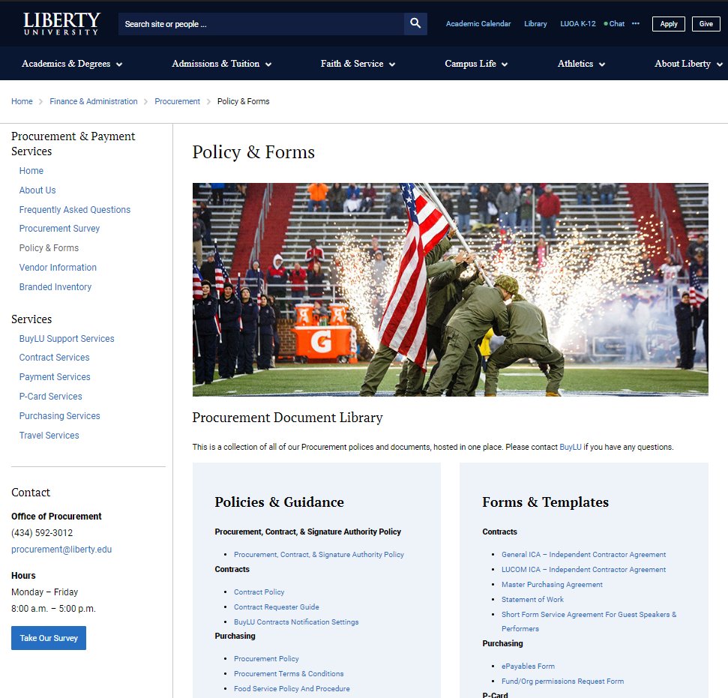
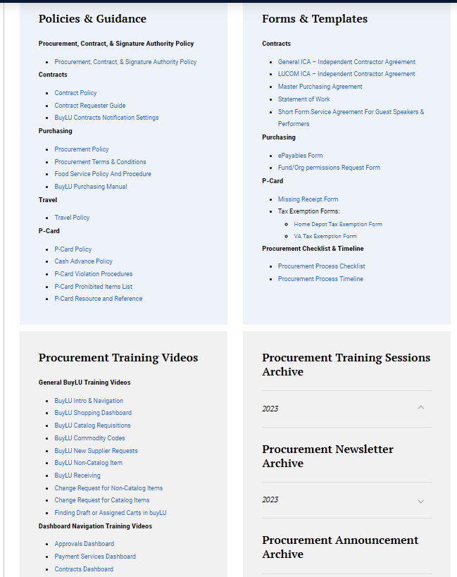
Procurement Training & Resources
Procurement Website
Training Videos
Document Library
Procurement Training Month – April 2024
Training schedule to be posted on Procurement website
Newsletter announcement

Slide 23
Procurement Planning Checklist

Slide 24
Procurement Planning Timeline
Supplier
Typical processing time: 1-3 business days
Supplier Request Submitted
Supplier Registration
Review/Approvals
Supplier Activated
Contracts
Typical processing time: 30+ business days
Contract Request Submitted
Contract Terms Reviewed & Negotiated
Contract Approvals & Signature
Contract Executed
Historically, they haven’t been close to warrant action.
Purchasing
Typical processing time: 1-3 business days
Requisition Submitted
Approvals
Requisition Processed
Purchase Order Distributed
Invoicing
Typical processing time: 1-3 business days
Invoice
Created
Approvals
PO, Receipt, and Invoice Matched
Payment Distributed

